Slide 1


December 2022
Co-Creation:Attainment Raising
Qualitative Research Report for Hello Future
CONFIDENTIAL

Slide 2
In this report
Overview: 3-34
Main Findings: 35-117
Section One: Executive Summary 3-34
Overview, Approach, Sample 4-14
Key insights and take outs 15-20
Summary of detailed feedback 21-34
Section Two: Context 35-91
The Student Perspective 37-73
  Educational Experience
  Attainment levels
  Higher Education
  Out of school support
The Parental Perspective 74-85
The Teacher Perspective 86-91
Section Three: Interventions 92-117
Rapid Reading 93-101
Co Creation Ideas 102-110
Delivering Interventions 111-117
About Cosmos 118-123

Slide 3
SECTION ONE:
Executive summary

Slide 4
OVERVIEW, APPROACH, SAMPLE

Slide 5

Overview
Background & Overall Research Objectives
Hello Future are in the process of implementing their revised Progression Framework model ‘Future Selves’ and want to ensure that attainment-raising interventions are well targeted and fully meet the needs of key student demographics.
Hello Future want to implement a comprehensive research programme in order to effectively identify skill and knowledge cold spots within the region, using the Framework and intervention themes as a basis.
The research needed to:
inform how these cold spots / gaps can be effectively addressed.
collaborate with students in order to effectively address how skill / knowledge gaps may be plugged with targeted interventions.
identify barriers and collaboratively identify solutions to those barriers where Hello Future can support.
understand and address the needs across the different attainment levels and learner needs groups

Slide 6
Detailed objectives (1)
Learners…
To capture an overview of their experience in education
To understand their perceptions of HE
To explore the current challenges and needs that students have
To explore students understanding of ‘attainment’
To explore how students view their academic performance: confidence in achieving predicted grades, view of own performance, factors that impact performance
To explore what activities students feel would help improve their attainment (and its relevance by learner need profile)
To understand what support they have received to date and the support they feel is needed going forward

Slide 7
Detailed objectives (3)
Parents…
To understand parents’ experiences of the education system to date with their child/ren
To explore parents understanding of ‘attainment’
To understand how parents feel their child/ren are performing academically, and the factors that influence this
To explore what types of activities parents feel would help raise attainment
To understand parents’ perceptions of university / HE
To understand how involved parents are in their child/ren’s future planning and how confident they are (or not) to impart advice, exploring any knowledge gaps
To explore any current challenges they feel their child/ren experience in education
To explore any support their child/ren receive and to explore their view of its effectiveness
To explore any unmet needs for key areas of support
To explore any challenges parents face relating to their child/ren’s education
To explore any support parents receive in relation to their child/ren’s education, identifying any gaps
To explore what activities and support might help address the challenges faced
To understand how Hello Future could support in the implementation of solutions/ initiatives with parents/ carers

Slide 8
Detailed objectives (2)
Practitioners…
To reflect on learner feedback of current challenges and support measures
To explore practitioners understanding and awareness of the OfS / Uni Connect emphasis on attainment
To explore perceptions of school vs regional attainment and any differences in attainment by learner need, gender or ethnicity
To explore practitioners current approaches to raising attainment
To identify current gaps in schools’ / colleges’ existing efforts around raising attainment
To understand where Hello Future could provide the most effective support in joint efforts to raise attainment, or by supporting outreach practitioners
To explore practitioners’ suggestions for attainment-raising activities/ approaches, and how these solutions will complement support already available to learners and explore how these solutions tie in with ideas suggested by students and parents
To understand how Hello Future can practically implement activities and work with schools effectively to raise attainment

Slide 9
Approach
Online workshops and interviews focussed on the topic of attainment raising with the aim to collaboratively identify and assess the most appropriate activities to inform and develop Hello Future’s intervention programme.
x4 Learner Workshops
1.5hrs on Zoom/ Teams
19 students across the 4 sessions
Year 9 (6 participants)
Year 9/10 (5 participants)
Year 10/11 (5 participants)
Year 11 (3 participants)
x2 Parent/Carer Workshops
1.5hrs on Zoom/ Teams
13 participants across the two sessions
x2 Teacher Depth Interviews
30 min Teams interview
Interviews / Workshops conducted in November 2022 by Sarah Dirrane and Kate Wood

Slide 10
Sample Detail: Students
Online workshops and interviews to collaboratively identify and assess the most appropriate attainment-raising activities to inform and develop Hello Future’s intervention programme
Learner Workshops: 19 students across the 4 sessions
Mixture of attainment levels across the sessions: from ‘sometimes needs extra help’ to ‘tends to exceed targets’
A number of different schools from across the region were represented
10 parents from these children took part in the Parent workshops
Learner need profiles (identified in Future Selves research) were represented in the groups: females, West Cumbrian, Furness
Recruitment took account of the postcode information provided by Hello Future.
Workshops broke down as follows:
Year 9 (6 participants): 3 male, 3 female; all White British
Year 9/10 (5 participants): 3 female, 2 male, White British x 4 ; White British Filipino
Year 10/11 (5 participants): 2 female; 3 male; White British x 3, Turkish Cypriot; Black British
Year 11 (3 participants): 2 male, 1 female; All White British

Slide 11
Sample Detail: Students
Attainment Levels – by workshop
 | 1 | 2 | 3 | 4
Has extra individual support | x1
Has extra individual support but meets targets | x1 |  | x1 | x2
Tends to meet targets | x2
Consistently meets targets |  | x1 |  | x2
Tends to exceed targets | x1 | x4 | x2 | x1

Slide 12
Sample Detail: Students
Additional Recruitment Information
Criteria for all:
Even split, male and female
Must have representation from each of the regions within Cumbria
  West Cumbria
  Furness
  Carlisle & Eden
Ethnicity, natural fall out
Socio economic status
  All to fit the postcodes and schools that Hello Future have provided
  The postcode tool was used to identify wards in the relevant regions to ensure a mix of schools identified as ‘attainment raising’ were included
School years 9, 10 and 11 must have representation from each year group
Need to represent the learner needs profiles across the sessions, flagging:
  Females (9 recruits)
  West Cumbria (3 recruits) / Furness (3 recruits)
  Cumbria (full sample)
  Yrs 9-11 West Cumbria (3 recruits)

Slide 13
Sample Detail: Parents / Teachers
Online workshops and interviews to collaboratively identify and assess the most appropriate attainment-raising activities to inform and develop Hello Future’s intervention programme
PARENTS: 13 participants across two sessions
10/13 were parents of children who took part in the student workshops
Mixture of attainment levels of children across the sessions: from ‘sometimes needs extra help’ to ‘tends to exceed targets’
A number of different schools represented from across Cumbria
All parents were White British
TEACHERS: 2 participants
Deputy Head
Personal Development Teacher and Drama Teacher
Both were recruited by Hello Future to take part in the research

Slide 14
Sample Detail: Parents
Additional Recruitment Information
Criteria for all:
To be parents of student/s who are attending compulsory education in either years’ 9, 10 and 11
Even split, male and female
Must have representation from each of the regions within Cumbria
  West Cumbria
  Furness
  Carlisle & Eden
Ethnicity, natural fall out
Socio economic status
  All to fit the postcodes and schools that Hello Future provided
Recruiter to capture parents’ perspective on higher education and level of involvement with their child/rens’ future decision making (recruit a mix of engagement).
Workshop 1: Mix of student ages and attainment levels, mix of schools, mix of daughters and sons. 7 respondents. 6 respondents had children taking part in the student sessions (8 children in total)
Workshop 2: Mix of student ages and attainment levels, mix of schools, mix of daughters and sons. 6 respondents. 4 respondents had children taking part in the student sessions (6 children in total)

Slide 15
KEY INSIGHTS & TAKE OUTS

Slide 16

Key Insights (1)
NEEDS
This student demographic has many unmet needs which Hello Future could potentially intervene and assist with.
The needs fall into a number of different areas:
  subject specific assistance (especially core subjects/Maths/Science)
  skills development (confidence, communication, understanding how to study/revise/prepare for exams)
  information and inspiration with regard to FE and HE.
It appears that there are many school-based interventions focused on attainment raising in year 11 for core subjects but fewer interventions for earlier years and for skills development. Schools appear to try and assist with information and inspiration for FE/HE but it feels relatively ‘light touch’ and has a limited impact on students.
Parents emerge as wanting to support and guide their children but not always having the skills or knowledge to be able to do so in an optimum manner.
Parents often emerge as being neutral at best with regard to HE, with uncertainty driven by cost/debt and their children moving away from home.
Students often express interest in HE and see many potential positives, but are also worried about cost/debt and moving away.
PARENTS

Slide 17
Key Insights (2)
There is a significant knowledge gap for students and parents in terms of practical steps towards FE and HE e.g. assessing options, writing applications, writing personal statements, knowing the requirement for courses, understanding financial implications.
Teachers could be open to and supportive of external interventions to support their students in raising attainment, providing they are consulted in order to ensure the interventions are well focussed and correctly delivered.
Teachers emphaise that personnel needs to be consistent, trained, and relatable. They sometimes envisage more need for external interventions outside of core subjects e.g. focussed on either raising aspirations OR helping students understand how to achieve their aspirations, inspiration, bringing subjects to life, skills development.
There is likely to be receptivity to interventions from students, parents and schools providing they are well-focussed and correctly delivered.
Give consideration to interventions which expand beyond a specific subject focus – this is particularly true for year 11s who have a lot of subject interventions from school.
TEACHERS
INTERVENTIONS

Slide 18
Key Take Outs (3)
INTERVENTIONS cont.
Interventions in the following areas could be of interest:
  Information and inspiration regarding FE/HE – for students and parents. Parents will be need to be ‘taken on the journey’ of understanding the potential positives of FE/HE
  Skills development: in particular around study/revision techniques, exam preparation, building confidence, building communication skills.
  Subject specific interventions: either revision sessions to recap on topics or sessions which have a different ‘feel’ to lessons e.g. practical, fun, memorable. Science and Maths are noted as key areas where additional assistance is required.
The Rapid Reading intervention does hold appeal and relevance but care will need to be taken to ensure it appeals to those who struggle with literacy. The voucher incentive is an important part of the concept but needs to be suitably motivating.

Slide 19
Key Take Outs (4)
INTERVENTIONS cont.
In terms of the format of attainment-raising interventions, preferences tend to be as follows:
  Within school day or tied to end of school day
  Ideally face to face and in groups
  c.60mins max.
  Opt-in by students – securing their buy-in to the process
  No preparation time required pre-session on the part of the student
  Run by experienced, trained and consistent personnel
It will be important to consult with teachers/schools in order to establish the most valued areas of focus.
Some teachers/schools may need reassurances that personnel delivering interventions are suitably trained and experienced, and able to connect with students.

Slide 20
Key Take Outs (5)
ATTAINMENT LEVELS
Students who required extra help (both in Yr 9 and Yr 11) appeared to be receiving adequate support and interventions, particularly in terms of core subjects.
  Yr 11 students at this level often reported to be working hard to ‘catch up’ and be able to achieve their aspirations, which could include HE.
Students who were meeting or exceeding targets gave mixed feedback:
  Yr 9/10: no significant additional support needs; all were comfortable with their progress
  Yr 11: despite exceeding targets some support needs with regard to specific subjects and with regard to general confidence /decision making for the future were reported. This was particularly the case for girls at this attainment level.

Slide 21
Summary of detailed feedback

Slide 22

The Student Perspective: In summary… (1)
The key points of the student perspective can be summarised as follows:
Educational Experiences
Educational experiences intensify in year 11 and school becomes more stressful, significant and demanding. The shift appears to feel quite dramatic to students, rather than gradual across the progressing years.
As a result, many students report feeling under considerable pressure in year 11 and sometimes report to be struggling, particularly in core subjects such as Maths and Science. Year 11s doubt their current performance levels far more than those in earlier years.
Covid appears to have contributed to a sense of being ‘behind’ and having ‘gaps’. Students also recognise that their own behaviour/lack of engagement in earlier years has contributed to additional pressure in year 11.
Schools frequently appear to offer many interventions to year 11 students, particularly around core subjects.
Knowing predicted grades is valued and helpful. Most students appeared to have at least an indication of what they may be, however increased conversations in this area (including on how to improve) could be valuable.
Students have clear needs in terms of building their wider skill set and wider personal development. This is particularly in terms of confidence, understanding their learning style and understanding how to approach revision and exam preparation.
Support
This sample of students report being relatively well supported via parents, siblings and key workers. There are also reports of schools being supportive via specific teachers, form tutors and specific interventions.

Slide 23

The Student Perspective: In summary… (2)
Future Goals
Many students have an idea of their future goals and possible direction but there is a significant gap in terms of understanding the specific steps /requirements to achieve these goals.
There appears to be more uncertainty from girls vs boys.
Further Education / Higher Education
There is interest in FE and HE, and students can cite many possible positives of progressing to university (e.g. meet like-minded people, new experiences, broaden horizons, focus on subjects of interest, improved employment/wages.)
The key envisaged negatives are cost/debt and moving from home.
Schools are reported to undertake some activity to help students with choices about their futures.
However, knowledge levels with regard to FE and HE remain very low. Specifically,
  Limited knowledge of how to write a personal statement and how to apply
  Uncertainty regarding choices available and requirements
  Uncertainty regarding how to assess colleges/universities
  Uncertainty regarding how to weigh up options and decide what is right for them and their goals

Slide 24

The Student Perspective: Key Take Outs
The key take outs from the student perspective can be summarised as follows:
There is potentially a greater need for external interventions for subject specific work in earlier years. Once students reach year 11, there appears to often be many school-initiated interventions for raising attainment in core subjects.
Beyond subject specific needs, there are significant gaps in terms of building skills and increasing knowledge of future options. For example:
  Confidence building and communication
  Understanding of future options and requirements to achieve goals
  Understanding of options for FE and HE
  Understanding of how to start and complete applications
These are areas which schools appear to try to cover but which require much more time and focus. Interventions for older years focussed on these areas could be useful.
Students often express interest in FE/HE but support is needed to cement and develop this curiosity. Most report that this doesn’t come from parents. Therefore, there could be a role for an intervention in this area (aimed at delivering information and inspiration.)

Slide 25
Attainment levels: Key Take Outs
Analysis of needs by attainment level indicates the following:
Year 9/10
Students generally report being well supported regardless of attainment level.
Across all attainment levels there can be interest in/confidence in progressing to HE.
Those requiring additional support feel that they are receiving it.
Differences between attainment levels and the level of support from home environments were not notable
Year 11
In year 11, support needs become more evident.
‘Requires extra’ –
  These students often report to be receiving useful subject specific interventions and assistance from teachers.
  Interest in HE is mixed but some do aspire to apply and are confident they can achieve a degree.
  Home support is evident.
‘Meeting/exceeding’ – students still have support needs and can have frustrations. They can request support in terms of
  Subject specific help: particularly if they have had a poor teacher, an absent teacher
  Non subject specific: building confidence, building knowledge about future choices

Slide 26

The Parent Perspective: In summary…
The key points of the parent perspective can be summarised as follows:
Parents recognise that there are a number of educational challenges facing their children e.g. gaps in subject knowledge, partly due to Covid; parents’ inability to assist their children; limited awareness of future options; low aspirations of the school, significant pressure during year 11.
They accept that the responsibility for educational success is three way: child, school, parent.
They often feel as though they are already providing additional support to their child. However, they frequently feel that they are not well placed to provide the required support and guidance.
This is particularly in terms of:
  Subject specific support when complexity of learning increases
  Navigating future choices and FE/HE options
There are a number of areas which they would like to receive additional support and information on – particularly around future choices.
They often feel that communication from school/teachers is poor, particularly pre-year 11.
Knowledge of HE is sometimes low and perceptions towards it vary: some parents are unconvinced of the benefits and very wary of the cost/debt and of their child moving from Cumbria.

Slide 27

The Parent Perspective: Key Take Outs
Parental feedback points to the following key take outs:
Picture clearly emerges that students do need additional help/support to reach their potential…
…and that (even willing /engaged) parents are often not optimally placed to provide this.
Potentially addressing some of the parental needs could aid progression to HE (via making them feel more informed regarding options and confident to assist child in decision-making)

Slide 28
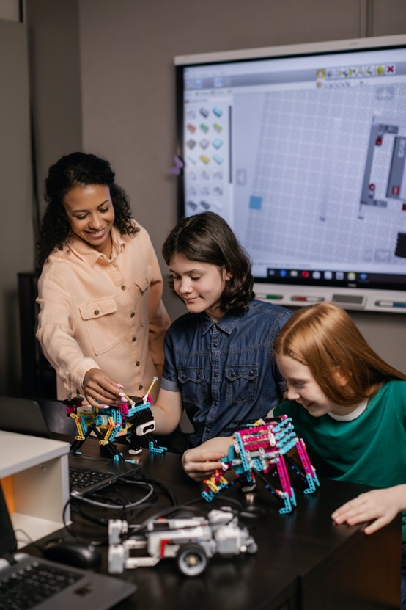
The Teacher perspective: In summary…
The Teacher Perspective emerges as follows:
Among the teachers who took part in this research there were polarised views.
Support and assistance needs are acknowledged and there is a strong desire to raise attainment.
But, care must be taken for Hello Future’s support to be focussed where schools require it. Consultation will be required.
Literacy/support on other core subjects are needed, but are potentially areas schools are more well-equipped to deal with via their teaching teams.
There are also key gaps to address in terms of providing inspiration, increasing aspirations/ helping students understand how to achieve their aspirations, driving engagement more generally and the provision of information regarding FE/HE.
Teachers stress that adequately trained, experienced and consistent personnel for any or all interventions will be key.

Slide 29

The Teacher Perspective: Key Take Outs
Teacher feedback points to the following considerations:
It is key to have consultation with schools prior to ‘launching’ an intervention: identify the gaps/ where the school requires help.
Literacy emerges as important but is often not the sole challenge. Plus, literacy is sometimes an area which schools have already designed interventions for. Some schools may require greater support in other areas.
Hello Future interventions focussed on building aspirations /confidence / understanding of future pathways may also be welcomed.
Interventions for Years 7-9 feel important: to build the link between focus in earlier years and success in GCSE years.
It will be important for Hello Future’s interventions to be delivered by appropriate personnel: adequate and ‘proper’ training, be relatable to students (i.e. similar background) and a consistent presence for rapport building.
Face to face/ at school premises interventions are likely to be required: issues with online engagement are expected.

Slide 30
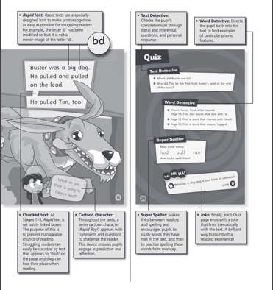
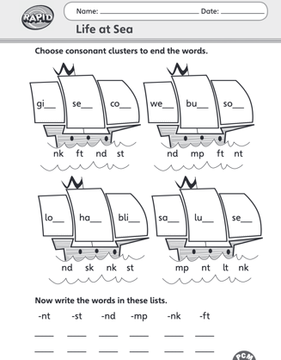
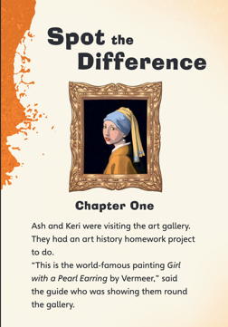
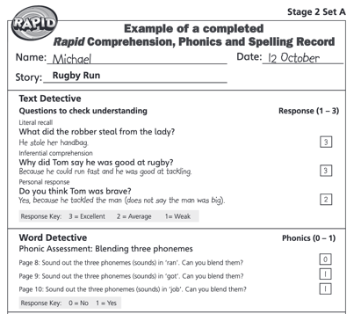
The Rapid Reading Activity is broadly endorsed:
Headline Reaction:
A positive intervention focussed on a key skill.
Provided that Rapid Reading is delivered well and doesn’t duplicate with programmes already in place, it should be welcomed.
Students:
Most are positive, although sometimes not overwhelming so. It is perceived as most suited to younger students e.g. year 9. it will be important for Rapid Reading to give a different (more interactive) experience vs class so that fatigue/boredom doesn’t set in. The voucher is motivating.
Parents:
Positive towards additional encouragement to read but they question how motivating the Waterstones voucher would be. The activity was perceived to best fit year 9.
Teachers:
Literacy is a key need but care must be taken not to duplicate with programs already in place. It will be important for course leaders/ interns to be fully/ properly trained.

Slide 31
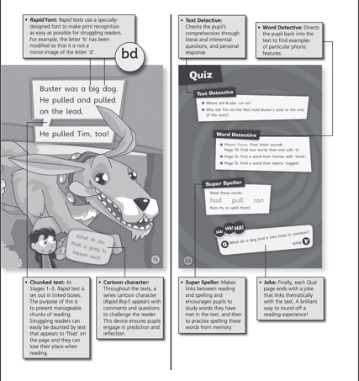
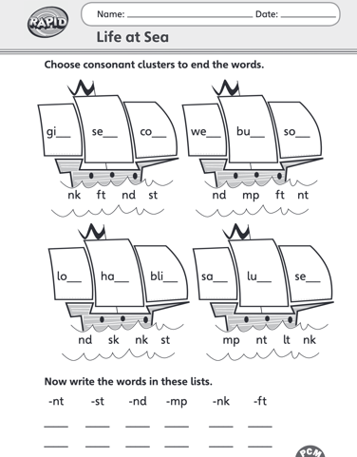

Rapid Reading: Key Pointers for Optimisation
Research points to the following:
The ideal target is younger age groups (e.g., Yr 9)
Hello Future will need to ensure it holds appeal for those that struggle with reading – therefore it needs to feel fun/interactive, non-pressured, and different to class work.
Remind students that this is a fun and easy way to improve their exam performance in later years.
Maintain the voucher reward but give consideration to rewards for each attendance or partial attendance and consider what type of voucher will be most welcomed.
Build the activity session into the school day or as part of post-school homework clubs
Ensure graduate tutors are consistent and well trained.
Consult schools regarding whether this is a needed/welcomed intervention – some schools might have literacy interventions in place and support would be better focussed on different activities.

Slide 32

Co Creation: Attainment-raising Interventions (summary)
Key Take Outs
Desired interventions focus on a mixture of content /objectives.
‘Intervention’ terminology shouldn’t be used (negative) – boost, elevate (or similar) are more positive ways to describe the sessions.
Key areas of interest include:
  Assistance with core subjects: Maths, Science, Literacy
  Revision sessions to aid memory/recall of what they ‘should’ know from earlier years
  Bringing core subjects ‘to life’ in an engaging manner e.g. practicals, viewing performances
  Skills-based support: how to revise, developing IT skills, building confidence, communication skills
  Information /guidance for future pathways e.g. FE/HE next steps
  Sessions should be designed to inspire and raise aspirations
  Parent focussed sessions could help, providing them with guidance on how to assist their children, guidance on future choices and the timeline for decisions.

Slide 33
Overview of intervention ideas by sample group
Students
Subject/Exam Specific Focus
Non subject specific skills
Revision: Subject Specific
Revision: Strategies
Practical sessions (Science, Drama)
Optimising learning – how to get more from lessons
Confidence building
Homework sessions: do homework at school /assisted
Subject specific tuition (esp. Science)
Exam techniques: working through papers with teachers
Helping with HE applications
Improving relationships with teachers
Parents
Teachers
Future guidance – more understanding of HE/ careers (for parent + child)
How to sessions: tips and techniques for revision (so parents can help)
How to sessions: how parents can support with homework
Sessions for younger years (before yr 11 overload)
Subject specific ‘top up’ sessions – especially for yr 11
Interventions to help inspire and increase aspirations
Assistance with school trips
Subject support

Slide 34

Delivering Attainment-Raising Interventions
Summary of Ideals /Expectations
Teachers, parents and students are all open to external personnel delivering interventions if they are adequately trained, have a good knowledge of the subject, and have appropriate authority
There is a desire for a mixture of subject-specific sessions, skills-based sessions and provision of information regarding future pathway options.
Students and Parents suggest that no additional preparation pre-session should be required.
30-60min sessions are the ideal, either solo or as a group
Opt-in (by students) is important – securing their buy-in to the process
The sessions should have a different tone to ‘normal’ lessons
Ideally these sessions would be delivered in-person, at school, tied to school day
Reasons to attend are most motivating when focussed on improved future prospects and grades.

Slide 35
MAIN FINDINGS

Slide 36
SECTION TWO:
CONTEXT

Slide 37
The STUDENT perspective:
education experiences

Slide 38

In this section
TOPIC CHART
Experiences of education and levels of support available 39-42
Impact of Covid 43
Predicted Grades 44
Building Skills 45-46
Current Performance 47-49
Future Goals 50

Slide 39



Student experiences vary by year group
Years 9 and 10 are often very positive, but there are consistent reports of pressure mounting quickly in Year 11
Years 9 and 10
Year 11
Students often report positive experiences with additional support offered when needed (see detail on following chart)
Realisation of the significance of the year
Challenges intensify: volume of work, difficulty in core subjects (esp. Science)
Pressure, mental health and anxiety are frequently mentioned
“
Up to year 10, school was alright and then it was just terrible. School tries to push you too much.
(Female, Yr 11, Furness)
“
When you get to year 11 it starts to get more serious, way more stressful.
(Male, Yr 11, Carlisle & Eden)
“
You don’t realise when you first get to Year 11 how close your exams actually are …you haven't got long left, so I realise now, now’s the time to start knuckling down and trying your best to get what you need.
(Male, Yr 11, Carlisle & Eden)
”
”
”

Slide 40
Examples of additional support
Additional help included the following:
Years 9 and 10
Form tutor: made students aware they could help if required; reminds of homework deadlines
General teaching support: breaking down the tasks and requirements to aid learnings
Additional support from PE teacher with areas of difficulty. Students often report positive experiences with additional support offered when needed e.g.
Year 11
Intervention sessions throughout school day
Mentor in SLT provided for assistance with science
“
“
So they’ll like come up to and they’ll just like take it down, they’ll break it like step by step so it's like you know what you're actually supposed to do for something, so it makes it easier.
(Male, Yr 9, Carlisle & Eden)
They pull you out of lessons or just come over and understand a bit of question you are struggling on.
(Male, Yr 9, West Cumbria)
”
”

Slide 41


Support is reportedly available, but gaps are evident
Whilst support within schools does appear to be available, there are still unmet needs. Availability of support appears to increase in years 10/11
Positively
Yr 9 suggest there is less need for help but report that form tutors are often supportive
More specific additional support is apparent during yr 10/11. For example:
  Additional assistance post-school on core subjects
  Support with dyslexia
  Teachers working in an assessment specific manner (i.e. how to interpret question / how to chunk info / how to structure answers)
Problematic areas
Gaps from not being on track in earlier years
Struggling to understand/ learn quickly enough
Covid gaps
“
I'd say like the first two years of school probably I was struggling a little bit, but since I'm learning at home I've been improving a lot and moved up a few classes.
(Male, Yr 9, Carlisle & Eden)
”
“
It's been pretty good, all the teachers are quite nice and they always give you support - they’ll come up to and they’ll break it step by step so you know what you're actually supposed to do, it makes it easier.
(Male, Yr 9, Carlisle & Eden)
”

Slide 42




Availability of support and guidance increases in year 11
Examples of the additional support and guidance received in year 11
Careers advice
After school extra sessions
Exam-focussed preparation
“
“
“
We had a meeting with a careers advisor at school.
I think that helped because there was kind of more degrees than I knew about.
(Male, Yr 11, Carlisle & Eden)
We’re getting a good amount of support because we’re in Year 11 and they’ve got the set compulsory things you've got to go after school.
English, maths and science you've got to go to, and there's some like optional ones like your option subjects your Spanish, your history them kind of subjects.
(Male, Yr 11, Carlisle & Eden)
With English, she's started breaking the questions down.
Our exam is in January, so the teachers tried to get lots of like mock exams in, which I think’s helping to put like the sentence structure in for the answers.
(Male, Yr 11, Carlisle & Eden)
”
”
”

Slide 43


The impact of Covid is still apparent
Most students, across the age groups, feel that Covid has led to increased educational challenges, thus potentially negatively impacting attainment levels.
Some students reported working more effectively from home with more autonomy – particularly girls in Yr 11
However most felt that online learning during the pandemic had led to gaps (it was difficult to participate fully and learn as much vs face to face)
Additionally students felt there was limited support to get back up to speed when they returned to the school environment. As a result all felt they had subject specific gaps from missing in-school learning.
  Year 11 students in particular emphasised the gaps they had from Covid – both subject specific but also in terms of understanding how to learn/revise/structure their time.
Parents also feel that their children had been ‘held back’ by Covid and had not fully caught up.
Students reported similar feedback on Covid related issues regardless of attainment level
“
When I was at home it was like you're in the comfort of your own home, you do have your own time to get around to stuff it's not like you're having a rush to do it at once. You're getting given the work and you work on it as needed.
(Female, Yr 11, Furness)
”
“
They just chucked us back in and went, follow these rules, like extra safety precautions, nothing really like extra to get you back up to speed or anything.
(Male, Yr 11, Carlisle & Eden)
”

Slide 44

Students value knowing their predicted grades
Whilst knowing predicted grades are valued, there are mixed experiences regarding awareness and conversations
Many students say they are made aware via report cards/feedback on work.
Students feel it’s important to know and engage with predicted grades. Those who are told predicted grades feel it is beneficial. (No clear differences by demographic)
However, only some report having conversations with teachers about them (e.g. discussing why/what they mean/how to improve)
There are indications that conversations about predicted grades are more beneficial than ‘receiving’ the grade in written feedback with no conversation.
One student disagreed with his predicted grades and had spoken about it with teachers/
One student felt that only some teachers ‘pushed’ for better predicted grades.
“
I'm the second best in Maths in my school but my target grade is a 6, so it doesn't add up... I have. to complain and get it [predicted grade] boosted back up.
(Male, Yr 11, Furness)
”
“
With the predicted grades we usually get that on like the report card at the end of the year, or like in the middle of the year.
(Female, Yr 9, Carlisle & Eden)
”
“
Yes we always have discussions about predicted grades and we started this year doing working towards Working At or Working Beyond and we done that instead of targets.
(Female, Yr 9, West Cumbria)
”

Slide 45
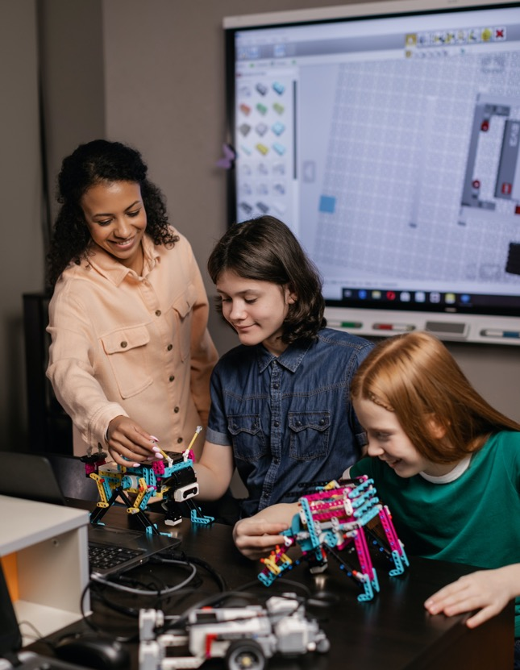

Building Skills: Clear needs exist
There are clear needs around building skills, particularly in terms of building confidence and awareness of learning styles.
Confidence issues are evident across the year groups, and potentially increase in year 11 as work becomes harder.
Confidence issues manifest in:
  Doubting their ability to learn and retain information
  Reluctance to ask teachers for more assistance / to ask questions in class
Learning styles: There was more evidence of older years being aware of their learning styles but many (across the year groups) report not knowing how to get the most from lessons /how to revise / how to ask questions.
Ability to do self-directed research: from year 10 onwards, there is evidence of ability to start some self-directed research into options but students find it challenging to ‘piece it all together’.
“
I would need more support if I was doing something newer, like I like to look before we start doing it in classes and stuff like that, to get an idea of what I'm doing.
(Female, Yr 9, West Cumbria)
”
“
I think I need like help like learning to remember things because I forget a lot and in computing because I barely know how to use a computer and I still kind of don’t.
(Female, Yr 9, West Cumbria)
”
“
I think my teachers sometimes are just hard to ask about stuff, but I do eventually learn.
(Female, Yr 9, West Cumbria)
”
West Cumbria Focus: Students do report requiring help with building skills, but requirements are fairly in line with other areas of Cumbria.

Slide 46

Building Skills: Some students believe they could have received more support
Students often highlight gaps with confidence levels and having the necessary skill set to adequately prepare for exams.
These issues are highlighted by yr 11 students, but they feel the ‘gaps’ stretch back to earlier years.
Students who report these issues are meeting/exceeding targets – important to recognise that this attainment level also has support needs (see specific section)
Insufficient help to overcome challenges/build confidence: student who consistently meets targets
Help required with revision: student who tends to exceed targets
“
“
I don't think, with my school they’ve tried to help me overcome challenges - they could have done a lot more. So I feel like if they would have helped me a bit more, especially with trying to learn my own ways of coming over things, it would have made me more confident for future, but I don’t believe they have done as much as they could.
(Female, Yr 11, Furness)
I mean I think we need to consistently be shown how to revise so [specific] sessions don’t need to be happening. We haven’t been told enough about it in younger years – making people aware of it in younger years is important.
(Female, Yr 11, Carlisle & Eden)
”
”

Slide 47

Current Performance: Concerns are more evident in later school years
Overall, students express a good level of confidence in their current performance
Students, particularly in year 9, report feeling confident about their current performance
More concerns are evident by year 10/11, particularly in terms of core subjects (Maths/Science)
That said, many feel they are working hard to attain required grades/ make amends for poor academic focus in younger years.
As students move through the years they begin to take more responsibility for their performance and increasingly appreciate the important of self-study/homework in order to fully understand topics.
There are many reports of interventions being available in year 11 to improve subject performance.
“
“
“
“
I'm doing really well, my form tutor has been really helpful, helping us out with anything I need, Like she’ll let us do homework whenever we need and she like reminds us when we need to do it, it's just, it's been really helpful.
(Female, Yr 9, West Cumbria)
My grades are quite good like I'm in all the top sets and that and, you know, if you're struggling you can tell the teacher and they’ll find different ways to like help you and stuff, so yea it’s going alright.
(Female, Yr 9, Carlisle & Eden)
For me, it’s science, it’s the teacher and also just so much crammed into one subject.
(Male, Yr11, Carlisle & Eden)
I was worried about my sciences but I'm seeking support [so] I think that it's most likely to come out with all the right grades. Knowing there was someone I could go to was pretty helpful.
(Female, Yr 11, Carlisle & Eden)
”
”
”
”

Slide 48

Current Performance: Specifics (1)
It is apparent that performing well becomes more challenging in year 11.
Understanding of ‘attainment’
Perceptions of current performance
Yr 9: all comfortable with current performance.
Yr 10: most are comfortable with current performance
Yr 11: some feel they are catching up in general or struggling in core subjects (‘requires extra help’ attainment level)
‘Tends to exceed targets’ Yr 11 still require help with performance :
  Female x 1 at this attainment level report needing to ‘work for it’
  Female at this level reports anxiety = missing lessons
Indication at male at ‘exceeds target’ is more confident regarding performance than females
Many students have no understanding of term.
“
“
Never heard it before, I don’t know what it means?
(Male, Yr. 9, Furness)
Does it mean attendance?
(Male, Yr. 11, Carlisle & Eden)
”
”
Take care with using ‘attainment’ terminology

Slide 49

Current Performance: Specifics
It is apparent that performing well becomes more challenging in year 11.
Areas of difficulty /challenge
Aspects which aid attainment
Procrastination /distractions
‘messing about’ in younger years
Using SATs to predict GCSEs
Year 10/11: difficulty/complexity and volume of work in core subjects (esp. Maths, Science)
Recognition from all ages that once you start to do homework and make effort, your performance improves.
Teachers are supportive.
Support from parents/siblings.
Tutor – paid for by parents.
Attending all of the interventions on offer.
Extra sessions via tutors/teachers
It is clear that, particularly by year 11, additional support/ interventions are required to support performance.

Slide 50

Future Goals: Varied levels of consideration are apparent
Most students have some idea of their goals/direction but there is a lack of clarity in terms of specific steps to take.
Many students do have areas of interest for future study /future careers. These aspirations are broadly based on what they find interesting currently e.g. Lego (engineering), football, fashion, crime. Girls often have more uncertainty vs boys regarding what they would like to focus on.
Many have rough ideas of what next steps might look like e.g. 6th Form , Uni, Apprenticeship.
There is a good level of confidence that goals can be achieved with hard work.
However, knowledge gaps are notable in terms of specifics (e.g. specific FE/HE choices and requirements) and many report not feeling ‘ready’ to make decisions.
“
“
“
I understand what the different options are, but I'm not sure what I want to do. I know that I want to do something that gets me onto A Levels and university but I'm not sure what yet really.
(Female, Yr9, Carlisle & Eden)
“
Well I'm fairly confident that I can achieve it [college/university], it's just that I think it's going to be quite hard to do so. Although I do think I can, if I put enough effort in then I’ll see results.
(Female, Yr 9, Carlisle & Eden)
I've always wanted to do something in science and crime, so I think that’s a good path. At the minute I'm in like top sets for all sciences so I think I've got a good chance.
(Female, Yr. 9, West Cumbria)
In school like we've had days where we’d learn about that type of thing in assemblies and then obviously you can ask any teacher and also like my parents support me and help me understand what I have to do.
(Female, Yr 9, Carlisle & Eden)
”
”
”
”
Students from West Cumbria mention requiring significantly more information about next steps, compared with students in other areas of Cumbria.

Slide 51
The STUDENT perspective: attainment levels and needs

Slide 52
The sample included students with different attainment levels
This section provides specifics by attainment level. As a reminder the sample included the following spread of attainment levels:
Attainment Levels – by workshop
 | 1 (yr 9) | 2 (yr 9/10) | 3 (yr 11) | 4 (yr 10/11)
Has extra individual support | x1
Has extra individual support but meets targets | x1 |  | x1 | x2
Tends to meet targets | x2
Consistently meets targets |  | x1 |  | x2
Tends to exceed targets | x1 | x4 | x2 | x1

Slide 53
Attainment levels: Key Take Outs
Analysis of needs by attainment level indicates the following:
Year 9/10
Students generally report being well supported regardless of attainment level.
Across all attainment levels there can be interest in/confidence in progressing to HE.
Those requiring additional support feel that they are receiving it.
Differences between attainment levels and the level of support from home environments were not notable
Year 11
In year 11, support needs become more evident.
‘Requires extra’ –
  These students often report to be receiving useful subject specific interventions and assistance from teachers.
  Interest in HE is mixed but some do aspire to apply and are confident they can achieve a degree.
  Home support is evident.
‘Meeting/exceeding’ – students still have support needs and can have frustrations. They can request support in terms of
  Subject specific help: particularly if they have had a poor teacher, an absent teacher
  Non subject specific: building confidence, building knowledge about future choices

Slide 54

DETAIL: ‘Meeting /Exceeding’ Attainment Level, Impact on needs
Specifics for ‘tends to/meeting/exceeding’ attainment level
Yr 9/10 (5 students – tends to/meeting/exceeding)
These students all tended to be more positive towards educational experiences and levels of support received and required.
Yr 11 (5 students – all meeting/exceeding)
Students sometimes required/wanted additional support despite meeting/exceeding targets e.g. when they claimed to have a poor teacher in a specific subject whom they felt was hindering their progress.
If a student had a specific learning need/disability (dyslexia) they tended to be more positive regarding the support and interventions received.
Girls (learning needs profile) sometimes felt that they weren’t performing as they needed to, despite the attainment level. They reported anxiety, poor relationships with teachers, missing schooling, bullying and were demotivated to look towards next steps. They also reported a knowledge gap in terms of how to research and decide upon future plans.

Slide 55
DETAIL: ‘Requires Help’ Attainment Level, Impact on needs (Yr 9)
Specifics for ‘requires extra help’ attainment level
Yr9 (2 students, one of whom met targets with the help)
Perform well with assistance but can feel pressured to ‘keep it up
Do feel supported - requests for some subject support but no significant requests for more wide ranging support
Mixed experiences in terms of support being offered at home by parents.
Mixed aspiration levels – some do express interest and confidence in going to University
*Note: small sub sample sizes
“
“
“
Teachers are alright, if I ask for help, they help. Like with work, if I don’t get it.
(Male, Yr9, Furness, has extra support)
“
I want to be a chef, I like food, if I don’t get that far, I’ll just have a café or something.
(Male, Yr9, Furness, has extra support)
I’ve been having tests and assessments thrown at me and I got them back and they are all quite high marks. It helped to have explanations for the parts I didn’t understand.
(Male, Yr. 9, West Cumbria, has extra helps but meets targets)
I think I need more help in geography – I don’t understand it as much as other subjects
(Male, Yr. 9, West Cumbria, needs extra helps but meets targets)
”
”
”
”
Indications that year 9 students at this attainment level respond well to additional support and have aspirations in line with other attainment levels.

Slide 56
DETAIL: ‘Requires Help’ Attainment Level, Impact on needs (Yr 11)
Specifics for ‘requires extra help’ attainment level:
Yr 11 (3 students)
Students sometimes report a ‘shaky’ or unsettled start in earlier secondary school years – but that things improved when relationships with teachers improved and when they (the student) started to ‘make an effort’
Good level of confidence that can achieve required/predicted grades – with more effort and the additional help offered.
That said there is nervousness and a sense that yr 11/important exams are very imminent (time running out to get up to speed)
Praise given to the levels of interventions offered e.g. ‘Intervention’ sessions - dinner break sessions, after school sessions; English teacher going through questions individually and breaking them out has lead to improvement
Difficulty with Chemistry – but recognition that behaviour in earlier years is a contributing factor
*Note: small sub sample sizes
“
I’d say Chemistry - it's probably just over the years of messing about and it does not go into my head, like I don't know, every time I have a lesson I don’t think I come away with one thing, it just doesn’t go in.
(Male, Yr. 11, West Cumbria, has extra help)
”
“
When I first started secondary school I didn’t have a very good start. I ended up getting excluded and it wasn’t a great start at my new school – but now it is more relaxed and settled.
(Male, Yr. 11, Carlisle & Eden, has extra help)
”
“
Well after these mocks I'm getting moved up to science because I said I want to learn more because I feel like I could get better grades than what I'm predicted. I'm getting extra tuition that the school pay for or the Trust or something pays for.
(Male, Yr. 11, West Cumbria, has extra help)
”

Slide 57
DETAIL: ‘Requires Help’ Attainment Level, Impact on needs (Yr 11) cont.
Specifics for ‘requires extra help’ attainment level:
Yr 11 (3 students)
Receive support from home and their is belief from parents in their ability. Parents sometimes pay for extra tuition. Have conversations with parents about future plans (post-school)
Some would like interventions to be more practical in nature – in order to move from the focus on reading/writing e.g. trips, practical activities
Aspirations and interest in HE: Mixed
  High interest: A ‘way out’ of local area and expanding experiences. Parental support/encouragement for university is also sometimes present. Confident that can go to University /achieve a degree.
  Low interest: Have decided that would prefer to get an apprenticeship and start work (follow in father’s footsteps / aim for a football course
  *Note: small sub sample sizes
“
If you look at subjects like English, history, geography, they're all lots of writing – it would be good to do activities which are a bit more practical.
(Male, Yr. 11, Carlisle & Eden, has extra help)
”
“
University, yes - it's just boring around here, there's actually nothing to do, there actually isn't. I mean like I've got to go to a park and sit on the swings, around here what people do - they just go and eat McDonalds and I don’t fancy getting fat.
(Male, Yr. 11, West Cumbria, has extra help)
”
“
University is just not something I want to do - getting an apprenticeship is for me, it’s what I want to do.
(Male, Yr. 11, Carlisle & Eden, has extra help)
”
Year 11 students at this attainment level are mixed. Some are resolute to raise their performance level and confident they can do so with effort and via embracing support. Others have different aspirations and confidence, and potentially require a different style of intervention if the goal is to drive to academia.

Slide 58
The STUDENT perspective: higher education

Slide 59

Student Perspective on HE: An overview
Interest and confidence to apply exists. Positivity towards the experience and benefits
(chart 60-61)
Negatives focus on cost and moving away from home
(chart 62)
Parents often appear neutral at best.
(chart 63)
Knowledge levels are low. Many feel poorly prepared to make decisions /apply.
(chart 64-65)
This is despite reports of activity at school /within lessons (Yr 11)
(chart 66)
Whilst schools do make efforts, significant gaps in terms of knowledge and preparedness for HE decision-making are evident. Parents often appear to be unconvinced of the benefits.
There is a potential role for Hello Future to assist schools with these gaps.

Slide 60

Students often express interest in knowing more about FE/ HE
Many students recognise that it is important to be aware of and engaged with FE/ HE options
There is recognition that FE/ HE decisions are an important part of their future.
  This is particularly true for years 10/11 - year 9s are more likely to feel it isn’t yet a priority.
Students also often express confidence and positivity towards what the university experience might offer them:
  A chance to focus on areas of interest
  A chance to meet like-minded people
  Potential for higher paid employment in the future
  Potential for better /broader life experiences
“
It is important because obviously like that’s our future ahead of us and if we don't know enough about it we’re not going to get very far.
(Female, Yr 11, Furness)
”
“
I'd like to know more because like I want to have a good future, so yes, because like I don't know much about it now and knowing about it would obviously help.
(Male, Yr 9, Carlisle & Eden)
”
“
I'm just kind of more excited to study things that I actually want to learn and that I actually enjoy, compared to just maths and science. Getting the opportunity to do more of what I really enjoy, I think that's what I would be anticipating.
(Female, Yr 11, Carlisle & Eden)
The world of HE is of interest to many students – Hello Future’s work to cement and solidify this interest is therefore strongly endorsed for continuation.
”

Slide 61


Positivity is shown towards progressing to HE
Students anticipate that going to university will provide them with many positives. Many express a good level of interest and confidence in HE
A route to more experiences and better employment options
An expectation of meeting positive people
A chance to meet like-minded people
“
I think someone that's passionate in getting what they want would go to university.
(Female, Yr 9, West Cumbria)
“
“
I feel like going to university is probably better because you know that there's a bunch of people who are interested in the same things that you are, so I guess that would be helpful.
(Female, Year 11, Carlisle & Eden)
I’ll be able to pursue what I'm wanting to do, I might be able to get higher pay, all my mates they don’t want to move away they all just want to do scaffolding, bricklaying and that's not me, I want to do something that's going to get me nice things, I want to go abroad, do you know what I mean.
(Male, Yr 11, West Cumbria)
”
”
”

Slide 62

The main concerns surrounding HE are the perceived cost and moving away from home
Students express concerns in these two areas:
Moving away from home
Cost
Students often expressed concern regarding moving from home – partly due to impact on parents/family.
Moving away concerns are also linked to cost.
Students assumed a high level of cost and debt.
However few expressed clarity regarding exact costs/finances required.
“
“
If I was going to go to university I'd probably have to move away, which is obviously quite a big decision and does impact my parents also. So thinking about that is kind of something that needs to happen between like parent and child, so I'd say that's quite important.
(Male, Yr 11, Furness)
Crippling debt!
(Male, Yr 11, Carlisle & Eden)
”
“
Negatives? It costs a lot!
(Male, Yr 11, Furness)
”
”

Slide 63

It is evident that HE is often not being ‘promoted’ as an optimum choice by parents
Students report that parents often give a neutral view on university as an option
(NB also see ‘Parental Perspective’ section)
“
“
My parents aren't actually bothered about it, they just want me to do something that will like make me happy, because they want me to do something that will give me a future but like keep me like entertained and like inspired at the same time.
(Female, Year 11, Furness)
I don't really know…like I've mentioned it before and they’ve said like we’ll happily like pay for you to go and that kind of thing but they’ve not really said if they'd want me to go.
(Male, Year 11, Carlisle & Eden)
”
”
“
“
I don’t know why but I just feel it’s[going to university] is not something I want to do. I just feel I'm doing my A Levels and getting an apprenticeship is for me and it's what I want to like do.
(Male, Year 11, Carlisle & Eden)
I think it's because our area, it's not the greatest and I think a lot of people have kind of put like a downer on it and I think that's kind of put like a thing in my mind of, well you know, everybody else isn't able to achieve that so am I going to be able to.
(Female, Year 11, Furness)
”
”
Research points towards the importance of bringing parents on the journey towards HE consideration. Could there be a role for Hello Future to assist with parental sessions?

Slide 64

Knowledge levels regarding HE are often low
Students have slightly more detailed knowledge of FE /6th form college but awareness of HE is very low – particularly in terms of practicalities (applying, assessing options, finances)
“
If school give us more information I’ll be more confident, we've wrote our CV’s but they’ve not told us how apply, they’ve not told us like where to go to if we need help, we've not even looked at like an example application form to get an idea of like the layout and the questions.
(Female, Year 11, Furness)
All students had very poor levels of detailed knowledge about how to action ‘next steps’ or what would be required of them in order to progress to FE/HE.
No students knew how to apply or write personal statements.
Some claimed their school had provided no guidance/information. Others referred to some sessions within school but they had failed to take in the information.
A minority of students claimed they would know where to find information independently if required (e.g. internet search)
”
“
I hear it a lot and my teachers talking about it and a lot of the time I don't know what they're saying.
(Female, Yr 9, West Cumbria)
”
“
I haven't thought about it because school haven't really given us enough information on it. What I know is from my own sources.
(Female, Year 11, Furness)
”
“
I don’t know what type of person would go to university – I’ve never met one. Posh people.
(Male, Yr 11, West Cumbria)
Furness (Learner Needs Profile): Year 11 students claim to know nothing about HE options or how to apply.
”

Slide 65

Year 11s also express a lot of uncertainty regarding next steps towards FE/ HE
Year 11 students express a sense of not being adequately prepared for decision making around their next steps.
They feel that they personally could have done more, and their schools/ teachers could have also given more direction.
This is particularly referenced in terms of attending college and university open days/fairs.
Inadequately prepared for college open evenings
Inadequately prepared university fair
“
I looked at mainly the colleges in the area to try and find like what courses they offer and what grades I need to get into the courses but I think I could have done a bit more. Like I went to a college open evening and they were asking me questions about the future and if I knew what grades I’d need and I realised I could have looked in a bit more depth.
(Female, Year 11, Carlisle & Eden)
“
It's like well we went to Liverpool to a university fair but the teachers didn’t give us any information about it, like previously, like they didn’t tell us like what questions to ask or really anything about it, they just kind of told us when we got there, go around, go, you know, look at universities and we were like well what are we actually meant to be doing or getting out of it.
(Female, Yr 11, Furness)
”
”
There potentially is a role for Hello Future to aid students’ preparedness e.g. sessions on FE options, sessions on HE options, guidance on how to get the most from college and university open days etc.

Slide 66

This uncertainty is despite schools’ undertaking some HE-directed activity
Activity in years 9/10 is reported as being limited. Year 11s do report some activity within their schools regarding FE/HE choices.
“
Our school has got really in-depth into it. They started like going through a lot of more careers stuff and today we even started looking at personal statements and that kind of stuff.
(Male, Yr 11, Carlisle & Eden)
Examples of activity in year 11 include:
  meeting with a careers advisor,
  personal development lessons focussed on researching options,
  focus on writing personal statements.
Despite this, many still report no awareness or confidence with taking next steps.
Potentially this is a reflection of:
  FE/HE not being the choice of previous generations within some households
  Students feeling overloaded with subject work so have limited ‘headspace’ for future choice information
  Insufficient information/consideration given in earlier years
Girls appear to lack confidence/uncertainty more than boys.
”
“
In lesson last week we started, the teachers got us on the computers and we started looking at open days for colleges and universities and that kind of thing.
(Male, Yr 11, Carlisle & Eden)
”
“
In our personal development lessons we research open days and what sort of facilities they’ve got online as well.
(Male, Yr 11, Carlisle & Eden)
”

Slide 67
The STUDENT perspective:
out of school support

Slide 68

Students generally claim to have role models and support outside of school
Most students described their parents and/ or older siblings as being role models and a source of support.
“
“
I just kind of get that extra bit of advice and techniques and they’ll always give me like a designated area to do my revision and send my siblings away so I've got like a quiet area.
(Male, Yr 9, Furness)
Well my mum does help us with my homework but a lot of the time she like does call like her cousins who are maths teachers, who can help explain it to us. So it's things like that.
(Female, Yr 9, West Cumbria)
”
”
“
“
My step-mum mainly helps me with English because she's got a degree in English, so like she’ll sit down and for example like she’ll go through Macbeth with me, help me make revision cards and then she puts them all around the house, so I've got to learn the quotes.
(Female, Yr 11, Furness)
Yes my brother’s 10 years older than me so he's always been on top and he's always been like the smarter one and I think just being like good at what I'm doing is like making me better than my brother, in some way. Yes, yes, well he got his Bachelor Degree not that long ago so I'm trying to push myself, kind of thing.
(Female, Yr 9, West Cumbria)
”
”
“
“
I don’t really ever need help with homework but she does help like motivate me to do it.
(Female, Yr 9, Carlisle & Eden)
”
When I have homework and let's say I'm struggling on it they’ll come and spend the time and like learn me on how to do it.
(Male, Yr 9, Carlisle & Eden)
”

Slide 69

Having positive role models and support networks is valued
Positive role models give students the confidence to succeed and motivation to ‘keep going’.
They fell in the following groups:
  Parents /Relatives: particularly when degree educated – can help with specific subjects
  Older siblings: a positive role model if go on to HE; can help with homework
  Friends: friendship group can be a source of support on homework /classwork /coursework
  Key workers: some students have key workers in place to provide additional support.
  Specific teachers: some students develop a specific/strong relationship with an encouraging teacher
“
I think it's very important [to have support] because sometimes when you don’t have confidence in yourself you need other people to have confidence in you, so that you know you can like succeed.
(Female, Yr 9, Carlisle & Eden)
”
“
If you're feeling like you're falling down at least you know that there's someone there to pick you up and carry you on that path.
(Male, Yr 9, West Cumbria)
”
However, it’s important to remember the potential sample bias based on households who came forward to participate in research.
Teachers reported that many students have limited role models and limited support at home.

Slide 70
The STUDENT perspective: SUMMARY AND key take outs

Slide 71
The Student Perspective: In summary… (1)
The key points of the student perspective can be summarised as follows:
Educational Experiences
Educational experiences intensify in year 11 and school becomes more stressful, significant and demanding. The shift appears to feel quite dramatic to students, rather than gradual across the progressing years.
As a result, many students report feeling under considerable pressure in year 11 and sometimes report to be struggling, particularly in core subjects such as Maths and Science. Year 11s doubt their current performance levels far more than those in earlier years.
Covid appears to have contributed to a sense of being ‘behind’ and having ‘gaps’. Students also recognise that their own behaviour/lack of engagement in earlier years has contributed to additional pressure in year 11.
Schools frequently appear to offer many interventions to year 11 students, particularly around core subjects.
Knowing predicted grades is valued and helpful. Most students appeared to have at least an indication of what they may be, however increased conversations in this area (including on how to improve) could be valuable.
Students have clear needs in terms of building their wider skill set and wider personal development. This is particularly in terms of confidence, understanding their learning style and understanding how to approach revision and exam preparation.
Support
This sample of students report being relatively well supported via parents, siblings and key workers. There are also reports of schools being supportive via specific teachers, form tutors and specific interventions.

Slide 72
The Student Perspective: In summary… (2)
Future Goals
Many students have an idea of their future goals and possible direction but there is a significant gap in terms of understanding the specific steps /requirements to achieve these goals.
There appears to be more uncertainty from girls vs boys.
Further Education / Higher Education
There is interest in FE and HE, and students can cite many possible positives of progressing to university (e.g. meet like-minded people, new experiences, broaden horizons, focus on subjects of interest, improved employment/wages.)
The key envisaged negatives are cost/debt and moving from home.
Schools are reported to undertake some activity to help students with choices about their futures.
However, knowledge levels with regard to FE and HE remain very low. Specifically,
  Limited knowledge of how to write a personal statement and how to apply
  Uncertainty regarding choices available and requirements
  Uncertainty regarding how to assess colleges/universities
  Uncertainty regarding how to weigh up options and decide what is right for them and their goals

Slide 73
The Student Perspective: Key Take Outs
The key take outs from the student perspective can be summarised as follows:
There is potentially a greater need for external interventions for subject specific work in earlier years. Once students reach year 11, there appears to often be many school-initiated interventions for raising attainment in core subjects.
Beyond subject specific needs, there are significant gaps in terms of building skills and increasing knowledge of future options. For example:
  Confidence building and communication
  Understanding of future options and requirements to achieve goals
  Understanding of options for FE and HE
  Understanding of how to start and complete applications
These are areas which schools appear to try to cover but which require much more time and focus. Interventions for older years focussed on these areas could be useful.
Students often express interest in FE/HE but support is needed to cement and develop this curiosity. Most report that this doesn’t come from parents. Therefore, there could be a role for an intervention in this area (aimed at delivering information and inspiration.)

Slide 74
the parent perspective

Slide 75
The Parent Perspective: In summary…
The key points of the parent perspective can be summarised as follows:
Parents recognise that there a number of educational challenges facing their children e.g. gaps in subject knowledge, partly due to Covid; parents’ inability to assist their children; limited awareness of future options; low aspirations of the school, significant pressure during year 11.
They accept that the responsibility for educational success is three way: child, school, parent.
They often feel as though they are already providing additional support to their child. However they frequently feel that they are not well placed to provide the required support and guidance.
This is particularly in terms of:
  Subject specific support when complexity of learning increases
  Navigating future choices and FE/HE options
There are a number of areas which they would like to receive additional support and information on – particularly around future choices.
They often feel that communication from school/teachers is poor, particularly pre-year 11.
Knowledge of HE is sometimes low and perceptions towards it vary: some parents are unconvinced of the benefits and very wary of the cost/debt and of their child moving from Cumbria.

Slide 76
the parent perspective: detail

Slide 77

Parents identify several educational challenges which their children face
The challenges fall into these headline groups:
Subject Specific Gaps
Skills based gaps: esp. how to revise
Limited personal knowledge of FE/HE
Aspirations of the school
Communication with school
Heightened pace and pressure at Yr 11
Covid increased these issues.
Parents do not always have knowledge to support their children with subjects/homework.
Teacher relationship issues contribute to gaps.
Parents have limited knowledge of FE/HE pathways
Driving to industry /apprenticeships vs HE.
Insufficient information and guidance on the full range of options available to students
Limited prior to year 11.
No parent/teacher relationship during earlier years.
‘Big’ decisions (e.g. options) comes too late.
Feel in the dark about timeline for decisions.
The shift to year 11 feels dramatic and intimidating (for both students and parents) – both the complexity and volume of work.
Pressures on students.
Mental health concerns.
Overt pressure on results.
Even when parents express the desire to support their children within education, they can often lack the knowledge and information to do so effectively

Slide 78

Key issues and challenges
Covid gaps
Shift in pace at year 11
“
“
Me and my partner are both keyworkers so we were, you know, non stop out the house during covid - we weren’t there at the time to say log in at this time, do this, do this, do this, you know, and unfortunately I feel like that's affected him and he's forgot things that happened in Year 9, Year 10, particularly with maths.
So now we’re having to pay for a private maths tutor to come in and go back to the steps in Year 9 and Year 10, those little, you know, critical things that he needs to know to catch up on.
(Mum, Parent of Yr 11 Male, West Cumbria)
As soon as we've hit year 11 there's interaction, there's contact all the time, the messages are coming through…. I feel like he has been coasting along until now and now he's in year 11, boom, the pressure is there
(Mum, Parent of Yr 11 Male, West Cumbria)
”
”
Aspirations of the school
“
The school is primed to get the children to go into BAE, that's pretty much what it seems to be around here.
(Mum, Parent of Yr 11 Male, Furness)
”

Slide 79

Parents recognise a responsibility towards their child’s educational success
Parents feel that the responsibility for educational success lies with parents / schools /children.
Many of them express a willingness to support their child/children but feel unequipped to do so.
Examples of parental support included:
Parents paying for private tuition when gaps are identified (e.g. Maths/Science) or no where there is no provision (e.g. Music)
Reminding / encouraging to do homework
Discussing predicted grades at home
Talking about future options
Supporting child’s choices (although often not guiding them)
When discussing future options, parents often expressed they were being led by their personal experiences/knowledge levels, rather than having a well-informed perspective.
In order to fulfil potential, it is clear that students ideally require additional support outside of the school classroom.
Parents are often happy to discuss future options with their children, but they need increased knowledge in order to support these conversations.

Slide 80

Parents report mixed levels of additional support and interventions from schools
In general support appears to step up during years 10/11
Positively:
Two Carlisle & Eden schools were called out for positive experiences of support, notably with Year 11s.
Interventions have included: helping a dyslexic child with coloured exam sheets, teacher getting a laptop for a child who requires it.
Year 9 options meeting at school to discuss choices
Zoom call with leadership team for all students
Year 10/ 11: Support by school is increased (e.g. early morning sessions, lunch and learn, after school, Saturday AM, teachers’ feedback, teacher mentors, after school sessions with food-based rewards, MyTutor online sessions)
Negatively:
Some negative experiences (although generally linked to certain teachers/ subjects) e.g.
  No chemistry teacher available
  Poor quality science teacher
  A teacher not checking accuracy of work, so student unaware if revising correctly – parent had to ‘step in’ and ‘teach’
Science is often a subject where additional support is required but not always available.
There appears to be more support gaps in earlier school years – school based programmes are stepped up during year 10 and 11.

Slide 81

Parents identified several areas where support would be beneficial
Empowering parents to play a role in raising attainment via…
“
Communication with schools
Earlier and better communication around issues, before it becomes a problem
More direct links to teachers to ask for help (multiple teachers per subject = harder communication)
Information from schools - for parents
More information on future pathways in FE and HE.
A clearer timeline for decision-making.
Guidance on where children can apply/ discuss what their options are
More information regarding grading /how to assist children in attainment-raising
Information/Support from schools – for students
More careers advice and guidance from schools – ‘fire up’ their aspirations
Yr. 11 - tips/ tricks on how to revise and how to structure their time
More focus on reading for this ‘podcast’ generation – in order to help with reading within exam context
I think communication is key…. When there is a problem you don't get told in the time that you can change things
(Mum, Parent of Yr 11 male, West Cumbria)
”

Slide 82
Parents frequently cite information gaps as a challenge
“
“
So they're in Year 9 and they’ll be choosing their options soon and nobody from school has ever sat with them and said, right what's the end goal, what do you think you might want to do as a career when you're older.
Because they're both quite academic, they don’t struggle with any subjects so they don't know what to choose and for me I can't wrap my head around the fact that there isn't somebody employed at the school to say to all the kids, right what do you think you might like to do as a career.
Right, so to end up in that job you need this Degree or you need this BTech or you need this other kind of qualification.
(Mum, Parent of Yr 9 female, Carlisle & Eden)
When you've never done it before, like now for our first child, she's our test run for it, our son, he's going to have a much easier ride because I'm going to know exactly what to expect for him.
Whereas when you're going through it for the first time you just, you don't know, you have to have all the information and currently I don't think we have any information at all about it.
(Mum, Parent of Yr 11 female, Carlisle & Eden)
”
”

Slide 83

There are mixed views from parents on the value of HE
The mixed views are in line with reports from students. Some parents place value on it, some would be supportive if child desires, others reject.
When concerns exist, they are frequently financial or due to the child moving far from home
Positive / Encourage
Neutral: unlikely to actively encourage
Reject/
dislike
If parents have attended university they are reported to be positive.
If students come back from open days feeling excited, parents encourage this excitement.
Parents question whether the debt is worth the benefit.
They express NOT wanting to influence in either direction.
Actively express disliking the possibility of their child going to university: moving from home, high cost, debt.
Frustration shown when schools encourage application.

Slide 84
There are mixed views from parents on the value of HE
Positive / Encourage
Neutral: unlikely to actively encourage
Reject/
dislike
“
My daughter who’s Year 12, she's now looking at university, they’ve gone to Newcastle to a university fair, the school had taken them across a couple of weeks ago and she came home absolutely buzzing about it.
(Mum, Parent of Yr 10 male, West Cumbria)
“
Not sure whether it's worth all the stress, all the finance, you know, me and my partner are both highly educated but you know, there's other ways and means of learning now without coming out with all the debt and the stress and all of that involved with going to Uni, but that's up to my son, that's up to him, you know, to go look at that path.
(Mum, parent of Yr 11 male, West Cumbria)
“
My eldest was guided very much by the head of sixth form and I was like, oh what do you mean you've applied for university?!I had no idea and then I was saying well, you know, what about the finance side, because nobody tells you any of that, you know, and I had to do that research myself. So I do feel better prepared but I don’t want to let any of my kids go to Uni again.
(Mum, Parent of Yr 9 male, West Cumbria)
”
”
”

Slide 85
The Parent Perspective: Key Take Outs
Parental feedback points to the following key take outs:
Picture clearly emerges that students do need additional help/support to reach their potential…
…and that (even willing /engaged) parents are often not optimally placed to provide this.
Potentially addressing some of the parental needs could aid progression to HE (via making them feel more informed regarding options and confident to assist child in decision-making)

Slide 86
Context:
the teacher perspective

Slide 87
The Teacher perspective: In summary…
The Teacher Perspective emerges as follows:
Among the teachers who took part in this research there were polarised views.
Support and assistance needs are acknowledged and there is a strong desire to raise attainment.
But, care must be taken for Hello Future’s support to be focussed where schools require it. Consultation will be required.
Literacy/support on other core subjects are needed, but are potentially areas schools are more well-equipped to deal with via their teaching teams.
There are also key gaps to address in terms of providing inspiration, increasing aspirations, driving engagement more generally and the provision of information regarding FE/HE.
Teachers stress that adequately trained, experienced and consistent personnel for any or all interventions will be key.

Slide 88
Teachers identify several key challenges in raising attainment
Key Challenges
Educational attainment levels
  Literacy issues are key – central to success in other subjects
Insufficient link made between earlier years and GCSEs
  Low engagement in earlier years causes problems later on
Low aspirations
  BAE Systems as primary local employer was repeatedly cited as requiring low grades and thus lowering students academic desire to strive for more.
  Fear of HE and debt are strong barriers to educational progression
  Community/social issues (drugs, crime, poverty) hamper aspirations
Schools sometimes have a well-developed programme focussing on literacy interventions. Fewer interventions are mentioned for the other areas.

Slide 89

Receptivity to Hello Future’s planned support to raise attainment is polarized… (1)
Positive: Additional help and support to raise attainment is needed and welcomed, but any intervention(s) need/s to be delivered appropriately
Positive:
Unaware of Hello Future’s new focus on attainment/academic focus
Positive reaction: teacher felt it is required and meets a gap.
Hello Future will need to:
Provide regular and consistent personnel to build rapport/make progress with students
Ensure personnel are relatable’; from similar background
Most interest in:
Role model sessions: people coming to school to speak about different options /broaden horizons
Literacy work: key for attainment across all subjects. Focus on those on a cusp of a higher grade or those falling behind.
Face to face – delivered by teachers for subject work or external personnel to support on activities/ careers information

Slide 90

Receptivity to Hello Future’s planned support to raise attainment is polarized… (2)
Wary: Collaboration and consultation will be required.
Unsure/wary:
Hello Future will need to consult with schools to avoid duplication e.g. literacy focus may result in duplication of effort.
Previous experience with Hello future was mixed: some mentions of previous intervention personnel not being sufficiently well trained
Hello Future will need to:
Consult with teachers to identify gaps and ensure that any interventions are successful
Reassure that personnel leading activities will be properly /fully trained
Use personnel to whom the students can relate.
Most interest in:
Development of subject-specific material which fits gaps/ doesn’t duplicate with school activities
Run after school revision clubs for year 11s/ homework club for other years
Face to face interventions as part of school day/immediately after are preferred – reportedly hard to engage students online (previous attempts have failed)
“
I don’t want to just have something thrust upon us.
”

Slide 91
The Teacher Perspective: Key Take Outs
Teacher feedback points to the following considerations:
It is key to have consultation with schools prior to ‘launching’ an intervention: identify the gaps/ where the school requires help.
Literacy emerges as important but is often not the sole challenge. Plus, literacy is sometimes an area which schools have already designed interventions for. Some schools may require greater support in other areas.
Hello Future interventions focussed on building aspirations /confidence / understanding of future pathways may also be welcomed.
Interventions for Years 7-9 feel important: to build the link between focus in earlier years and success in GCSE years.
It will be important for Hello Future’s interventions to be delivered by appropriate personnel: adequate and ‘proper’ training, be relatable to students (i.e. similar background) and a consistent presence for rapport building.
Face to face/ at school premises interventions are likely to be required: issues with online engagement are expected.

Slide 92
SECTION THREE: Potential interventions FOR RAISING ATTAINMENT

Slide 93
RAPID READING ACTIVITY

Slide 94
The Rapid Reading Activity was introduced as follows:
Rapid Reading Activity
Graduate Interns will visit the school and lead a guided reading session with each group using a ‘Rapid Reading’ literacy intervention packs.
This involves activities such as reading stories, taking part in a short quizzes and other reading specific activities, see examples.
Graduate interns will be in their early 20s
The groups will be staggered over a 6-week period
£25 Waterstones book voucher received for taking part

Slide 95
The Rapid Reading Activity is broadly endorsed:
Headline Reaction:
A positive intervention focussed on a key skill.
Provided that Rapid Reading is delivered well and doesn’t duplicate with programmes already in place, it should be welcomed.
Students:
Most are positive, although sometimes not overwhelming so. It is perceived as most suited to younger students e.g. year 9. it will be important for Rapid Reading to give a different (more interactive) experience vs class so that fatigue/boredom doesn’t set in. The voucher is motivating but thought must be given to the type of voucher.
Parents:
Positive towards additional encouragement to read but they question how motivating the Waterstones voucher would be. The activity was perceived to best fit year 9.
Teachers:
Literacy is a key need but care must be taken not to duplicate with programs already in place. It will be important for course leaders/ interns to be fully/ properly trained.

Slide 96
Whilst the Rapid Reading Activity is broadly endorsed there are some ‘watch outs’
Key Benefits
Areas of Concern
Students:
Recognise it could help with their overall performance/ exam performance.
Expect it to be interesting and interactive (e.g. quizzes)
Meeting graduate interns (new people) could be of interest.
The sessions could increase their confidence.
The activity would benefit their imagination, thinking and memory.
Envisage a supportive environment – someone reading to you so less pressured.
Some envisage as a (better) alternative to class.
Parents/Teachers:
Literacy identified as a need, so in theory support in this area could be beneficial.
Most interest from those who have an interest in reading. Some suspicion that those who struggle with reading or find it boring would not attend (particularly flagged by ‘needs extra help’ attainment level).
Year 11: Less interest in participation, or may participate solely for voucher
Voucher: students endorse in principle but parents question how motivating a reading voucher would be.
Overlap with classwork: Too much reading practice leads to boredom/fatigue.
6 weeks: A long commitment. Students question whether they would attend all sessions.
When the sessions would take place: need to be within the school day or linked to school day. Unlikely to participate otherwise.
Interns: teachers stress the need for them to be fully trained and ‘relatable’. Will need consistency to build rapport.

Slide 97
Rapid Reading Activity: Detail (1)
Most suitable for
Motivations to participate
“
I think Year 9’s like before they get to that, when you're mainly focusing on GCSEs and learning like Year 9’s, so they already have that knowledge and them tools before it starts to get a lot harder.
(Female, Yr 11, Furness)
Year 9s – in order to give them the reading foundation they need for future years when work intensifies.
Take care for the intervention to appeal to those who are struggling (i.e. the least likely to come forward)
The following are reasons to participate and could be referenced within communications:
Fun, interactive, no pressure.
Reading to you – no pressure to read out loud.
Different to class.
Will help build confidence.
Will help for exam performance later on.
Voucher available.
Run by a young external team.
Positive ‘reviews’ from students in previous years.
Incentives/rewards.
‘Rapid’ positive: likely to appeal
“
It would help with your reading and the way that it's, you're getting money for it wouldn’t feel like a chore, it would feel more like something you want to do.
(Female, Yr 9, West Cumbria)
”
”
“
Mine would absolutely love it but they are girls, I think there might be a difference between girls and boys.
(Parent, Yr 9 female, Carlisle & Eden )
“
The quizzes sound fun and you could get out of lessons – maybe meet new people.
(Female, Yr 9, Carlisle & Eden)
”
”
“
“
It would have to be fun, it would have to be something that really engaged with them. The target group that you're looking at are obviously not doing a lot of reading so, you know, that kind of thing just might not even interest them, full stop.
(Parent, Yr 10 male, West Cumbria)
With exams, you have a reading one so something like this could help with your exams.
(Male, Yr 9, Carlisle & Eden)
”
”

Slide 98
Rapid Reading Activity: Detail (2)
Reaction to voucher
Reaction to graduate interns
Providing a ‘monetary’ incentive is strongly endorsed by all
Students don’t raise concerns re Waterstones (although some refer to £25 as generic ‘payment’)
..but parents question how motivating it will be
Some concerns that attending for 6 weeks could be a challenge.
Potentially shorter-term incentives as students progress are worth considering (e.g. after attending 2 sessions…)
Evidence that small rewards /treats are motivating (e.g. food rewards / food built into the sessions)
Students: Endorse. Meeting new people holds appeal for some students; younger people appeal
Good for it to be feel different to normal school classes
Good for students who claim to have a difficult relationship with their subject teacher
However, teachers stress that graduate interns need to be fully trained and a consistent team who can build rapport with students
Parents stress they need authority vs trying to be liked/a friend
“
“
It depends on their [graduate intern] engagement with the children and if they're trying to be a child, which you find with some younger teachers, they're just too, they're wanting to be liked too much.
(Parent, Yr 9 female, Carlisle & Eden)
Considering you’re getting paid, I think you’d get a lot of interest in it.
(Male, Yr 11, Furness)
”
”
“
It's not an incentive if you're asking kids to read, yes. Yes I don't know, I mean our lad probably would pay attention for the first 10 minutes and then he'd be off on something else I think.
(Parent, Yr 9 male, Furness)
“
Not being a teacher I think is a good thing, because they're seeing it from the teachers in class all the time don’t they, so it not being done by one of their normal teachers.
(Parent, Yr 11 male, West Cumbria)
”
”
“
“
I don't know if that incentive, that book voucher would entice the type of students who might need that extra help. I think it's really difficult to incentivise a reading task with a reading reward.
(Parent, Yr 10 male, Carlisle & Eden)
I think younger people will talk to people who’s similar to their age or some, like a 40 year old man or woman trying to speak to a 15 year old they're not going to be completely open. If it's someone who is around that age group, like more of a youth then they're going to talk more.
(Male, yr 11, West Cumbria)
”
”

Slide 99


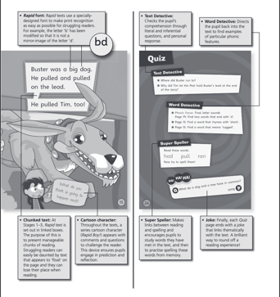
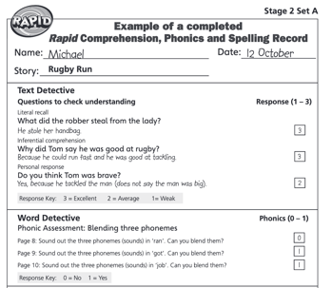
Rapid Reading Activity: Student Perspective
Rapid Reading Activity
I think it like could make people feel more confident in like their reading
(Female, Yr 9, Furness)
“
”
“
It looks alright but I used to do something like that and I didn’t really enjoy it, so I don't know if it's going to be like my thing.
(Female, Yr 9, West Cumbria)
”
“
I think that in short term benefits would probably be that people are like having fun whilst learning.
(Female Yr 9, Carlisle & Eden)
”
“
In my school in form time we do that, like almost every day anyway.
(Female, Yr 9, Carlisle & Eden)
”
“
It looks good because guided reading is always like pretty good to like learn stuff, because you're not actually reading it , you can kind of just like listen to it
(Male, Yr 9, Carlisle & Eden)
”
“
Considering it would be six weeks long I guess students might miss sessions which causes them to fall behind from other students in the group. They might lose interest.
(Female, Yr 11, Carlisle & Eden)
”
“
Interesting to do - the way it's set out so it's not just like paper with questions on it, it's more interesting to look at.
(Female, Yr 9, Carlisle & Eden)
“
”
An alright idea for some but I know that not a lot of people enjoy literacy and reading and what not.
(Male, Yr 9, West Cumbria)
”

Slide 100
Rapid Reading Activity: Parent Perspective
Rapid Reading Activity
“
Definitely worth a try. Anything that's extra reading it has to be, it has to be beneficial because children just aren't reading generally under their own steam anymore.
(Parent, Yr 10 male, West Cumbria)
“
It probably depends, you know, if it was out of school time they'd go no, you know, if they were getting out of a lesson they didn’t like they'd probably go yeah they’ll do it.
(Parent, Y9 and Yr 11,male/ female, Furness)
”
”
“
I think it's good because I know my son his, one of his strengths isn't reading things and absorbing the text, so I think that it's where he may fall down in exams. So I think that's one really, really good positive activity for revising.
(Parent, Yr 11 male, West Cumbria)
“
My son might well do it if it was in school time, but it's not something I could persuade him to do outside of school time.
(Parent, Yr 10 male, West Cumbria)
”
”
“
I find this is a generation now that don’t read, they look for everything online or they ask Siri and Alexa. Or they’ll listen to a podcast. So I feel as though it is a key skill that they're losing, so when it comes to putting them under pressure for exams and they’ve only got an hour to read long exam papers, I feel as though it's a skill that needs to be built on.
(Parent, Yr 10 male, Carlisle & Eden)
“
The word rapid I think helps a little bit but I think, you know, yes, it's any kind of worksheet thing, you know, quite a few of the children would really struggle with.
(Parent, Yr 10 male, Carlisle & Eden)
”
”

Slide 101
Rapid Reading: Key Pointers for Optimisation
Research points to the following:
The ideal target is younger age groups (e.g., Yr 9)
Hello Future will need to ensure it holds appeal for those that struggle with reading – therefore it needs to feel fun/interactive, non-pressured, and different to class work.
Remind students that this is a fun and easy way to improve their exam performance in later years.
Maintain the voucher reward but give consideration to rewards for each attendance or partial attendance and consider what type of voucher will be most welcomed.
Build the activity session into the school day or as part of post-school homework clubs
Ensure graduate tutors are consistent and well trained.
Consult schools regarding whether this is a needed/welcomed intervention – some schools might have literacy interventions in place and support would be better focussed on different activities.

Slide 102
CO-CREATION IDEAS FOR RAISING ATTAINMENT

Slide 103

Co-creation: Idea generation for interventions focused on raising attainment
Following the exploration of the ‘Rapid Reading’ activity, students, parents and teachers were asked to think of ideas for useful ‘interventions’ to raise attainment

Slide 104
Overview of ideas by sample group
Students
Subject/Exam Specific Focus
Non subject specific skills
Revision: Subject Specific
Revision: Strategies
Practical sessions (science, drama)
Optimising learning – how to get more from lessons
Confidence building
Homework sessions: do homework at school /assisted
Subject specific tuition (esp. Science)
Exam techniques: working through papers with teachers
Helping with HE applications
Improving relationships with teachers
Parents
Teachers
Future guidance – more understanding of HE/ careers (for parent + child)
How to sessions: tips and techniques for revision (so parents can help)
How to sessions: how parents can support with homework
Sessions for younger years (before year 11 overload)
Subject specific ‘top up’ sessions – especially for yr 11
Interventions to help inspire and increase aspirations
Assistance with school trips
Subject support

Slide 105
Overview: Students
Student ideas fall between subject-based activities and skills-based activities
Students
Non subject specific skills
Subject/Exam Specific Focus
Revision: Subject Specific
Revision: Strategies
Practical sessions (science, drama)
Optimising learning – how to get more from lessons
Confidence building
Homework sessions: do homework at school /assisted
Subject specific tuition (esp. Science)
Exam techniques: working through papers with teachers
Improving relationships with teachers
Helping with HE applications
Students place significant focus on subject specific work/revision, reflecting that they struggle to grasp the full content of lessons within the designated timeframe. They would like additional time to work through curriculum content. Revision of topics is often a priority.
Yr 11 students regardless of attainment level request more support in these areas. ‘Needs extra help’ attainment level request subject specific help and practical sessions. ‘Meets/exceeds’ requests help with exams and revision.
There is also a need for activity beyond subject specific work: building confidence (e.g. to ask questions, speak up); getting guidance on how to get more from lessons; rapport building with teachers (starting from a young age)

Slide 106
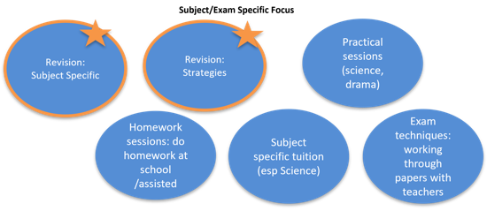
Overview: Students
Student ideas fall between subject based activities and skills-based activities
Non subject specific skills
Optimising learning – how to get more from lessons
Confidence building
Improving relationships with teachers
Helping with HE applications
“
“
Revision clubs, that would be pretty cool, like so you can revise with your friends.
(Female, Yr 9, Carlisle & Eden)
Practical things, because a lot of subjects contain a lot of writing. Like in English, see a performance so you see how characters interact.
(Female, Yr 11, Furness)
“
”
I mean we've had Hello Future in quite a lot telling us about the stuff, but I think we just need to know how to write these applications.
(Male, Yr 11, Furness)
”
”
“
“
I think definitely go over like the practicals that you'd do multiple times because like we've been told we have to memorise loads of practicals and how to do then but then we only do them once or sometimes we don’t even do it, we just read about it.
(Female, Yr 11, Furness)
Doing stuff like maybe looking at exam questions for example or like maybe past exam papers could be helpful. So looking at what people have answered before, and how to improve on stuff like that, them sort of activities might be helpful.
(Female, Yr 11, Carlisle & Eden)
“
I did a six week programme where it was a confidence builder. Somehow improved my grades by like speaking out more in class and asking for help.
(Female, Yr 9, West Cumbria)
”
”
”

Slide 107
Overview: Parents
Parents often place most focus on more information regarding future choices e.g. FE/HE/ Careers rather than attainment-raising activities.
Parents
Guidebooks
Online resources
Online chat groups with teachers/ parents
University /college visits (informal)
Information provided earlier (e.g. yr9/10)
Uni students to visit school for inspiration talks
Information on how to apply
Sessions for younger years
(before year 11 overload)
Additional Learnings
Parents stress to not use ‘intervention’ within terminology: negative connotation. ‘Boost’ or ‘elevate’ is more positive.
Need to take care that the sessions are not stigmatised.
Parents have concern about overloading children. Within the school day is the most natural fit for activities, but, that said, they feel there is not free time to fit ‘more’ in
After school or at home is difficult in light of levels of homework.
Parents would prefer online contact/access to activities – more flexibility.
Future guidance – more understanding of HE/ careers (for parent + child)
Information on FE/HE/work – delivered early enough to impact on aspirations.
Subject specific work for gaps
How to sessions: tips and techniques for revision (so parents can help)
Subject specific ‘top up’ sessions – especially for year 11
‘Covid’ recaps
‘Opt-in’ – i.e., student choice
Ideally within school time.
Avoid it being a significant on going commitment
Ideas for planning revision/how to revise/ prepare
How to sessions: how parents can support with homework
Bitesize information for parents e.g. curriculum, tips/ techniques
(NB These ideas are from parents)

Slide 108
Overview: Parents
Parents often place most focus on more information regarding future choices e.g. FE/HE/ Careers
“
An element of it that I feel slightly ashamed that, you know, we think that we’re guiding them and doing our best but actually are we giving them the correct information, I don't know.
(Parent, Yr 10 male, Carlisle & Eden)
“
“
When I was at school they did bitesize revision for kids, so it would be good if they could do something like that for parents, so it's like a bitesize this is what your curriculum is for Years 9, 10, 11, these are the sorts of methods we use for teaching it, whatever it is.
(Parent, Yr 9 male, Furness)
A booklet of ‘this is what is available within our area, this is where last year’s Year 11’s progressed after their GCSEs’, I would like to know what the last year’s pupils did for example, you know, how many of them went on to do apprenticeships, how many went on to do this,, how many children went to university. I'd like to know what happened to the children after they left the school to think oh well maybe these are options for my child.
(Parent, Yr 9, Yr 11 male/ female, Furness)
”
”
”
“
“
“
More towards the parents, it's just how we can advise and guide the children with exams and also, you know, the future with college or universities. Or even if it wasn’t guidebooks if it was like online as well because I think we can access things much easier online.
(Parent, Yr 10 male, Carlisle & Eden)
Maybe if there was opportunities for people who are like 18, 19 year olds to go into the schools to talk to the children, so to Years 10, 11 and they talk about their own experience, the routes that they went down, because I think they would listen to them.
(Parent, Yr 10 female, Carlisle & Eden)
In terms of access to higher education that I haven't been spoken to about anything as such as a parent and now I feel like this is now Year 11, the most important year and that pressure is then added on top of the GCSEs. So maybe possibly if like in Year 10 then it was sort of started to be addressed a little bit earlier.
(Parent, Yr 9, Yr 11 male/ female, Furness)
”
”
”

Slide 109
Overview: Teachers
Teacher ideas extend beyond subject specific support for raising attainment
Teachers
Assistance with school trips
Interventions to help inspire and increase aspirations
Subject support /Literacy Support
Additional Learnings
Consultation is key
Subject-specific support is welcomed if delivered by trained personnel
Activities to build aspirations are also important and often a gap currently.
WHO runs the sessions is AS important as the actual content
e.g. accompanying a theatre trip, running a session post-trip to maximise take outs
Visits from positive role models
Work from Yr 7 inwards to set expectations and engage students
On any required subject (but consult with school as to key needs)
Literacy recognised as an important area, but programmes might be in place.
Science could also be a focus (based on student feedback)
Interventions could be after school revision sessions, involvement in homework clubs
“
If they [Hello Future] could run sessions that tied in with trips it would extend the learning
“
We need someone in school who is a familiar face and over time they [students] will know who to go to for help
”
”

Slide 110
Co Creation: Attainment-raising Interventions (Summary)
Key Take Outs
Desired interventions focus on a mixture of content /objectives.
‘Intervention’ terminology shouldn’t be used (negative) – boost, elevate (or similar) are more positive ways to describe the sessions.
Key areas of interest include:
  Assistance with core subjects: Maths, Science, Literacy
  Revision sessions to aid memory/recall of what they ‘should’ know from earlier years
  Bringing core subjects ‘to life’ in an engaging manner e.g. practicals (Science or Arts), viewing performances
  Skills-based support: how to revise, developing IT skills, building confidence, communication skills
  Information /guidance for future pathways e.g. FE/HE next steps
  Sessions should be designed to inspire and raise aspirations
  Parent focussed sessions could help, providing them with guidance on how to assist their children, guidance on future choices and the timeline for decisions.

Slide 111
Delivering ATTAINMENT-RAISING interventions

Slide 112

Interventions: Format Preferences (1/5)
Intervention preferences were explored via the following framework:
WHAT sessions should be like /cover
WHO should deliver interventions
WHERE should interventions happen
HOW to ensure sessions are useful
WHY students would want to take part
WHEN sessions should take place

Slide 113

Interventions: Format Preferences (2/5)
Time: 30-60 mins, potentially more as move towards GCSEs/A Level.
Longer face to face and shorter online.
Group vs solo: Generally most interest in group sessions (less pressured) but openness to 1-2-1 work if need additional support.
Content: A mixture of subject specific sessions, skills-based sessions and provision of information regarding future pathway options.
Ideally no additional preparation required (days are already full up with learning/homework)
(See detailed ideas on slide 104)
Tone/style: Important for sessions to feel different to lessons.
Interactive, fun, informal. Rewards included.
By choice: Student’s choice to attend – they opt in. Not too onerous in terms of on-going commitment.
“
“
“
In my school people come in and do like quizzes on things, just like general things and you get rewards like sweets or chocolate if you do it. You could do like questions related to things you're learning in the school.
(Female, Yr 9, Carlisle & Eden)
“
“
I think knowing that it's not just going to be like normal lessons, it's going to be a bit more fun, it's going to be more based on what you want to learn and what you want to know.
(Female, Yr 11, Furness)
Just go whenever you want to go, like you don’t have to go every week or like every single day, it's like if you need the help and like support then you can just go and turn up, but if you don’t want the help then you just don’t go.
(Female, Yr 9, Furness)
Giving examples of different strategies to help people who maybe haven't found how they learn best, maybe work out something like a strategy to help them.
(Female, Yr11, Carlisle & Eden)
There's like all the like biology and physics all that being crammed into one, you could do like one session on biology and then another one on physics and then chemistry. So you could space it out.
(Male, Yr 11, Carlisle & Eden)
”
”
”
”
”

Slide 114

Interventions: Format Preferences (3/5)
Openness to being run by internal staff or external people – assuming have relevant skillset/experience
Teaching staff feel like the most obvious choice for curriculum learning: they know the subject and the students.
However, those students with poor teacher relationships welcome a change.
External personnel are most obvious choice for raising aspirations /inspiring students (e.g. older students returning to the school) or if they have specialist knowledge of a subject.
Recognition that external personnel are useful to differentiate from ‘normal’ lessons – provide a ‘freshness’ which can lead to more engagement.
“
“
“
“
I do understand if you don’t like a teacher and it might be harder to learn, but I feel like if you know them it's like a lot easier to learn because you're less awkward, I guess.
(Female, Yr 9, West Cumbria)
Could be like a teaching assistant kind of figure that that knows stuff about the subjects and can get the stuff from teachers, but you don’t really have a relationship with them yet and you can build on that because if you already have a relationship with a teacher that might sway if you want to do it or not.
(Female, Yr 11, Carlisle & Eden)
If it's like a teacher that you don’t really like doing it then you might just be completely put off doing it because they're the one doing it.
(Female, Yr 9, West Cumbria)
Run by school I think because you'll have more like you'll feel more comfortable around the people that you know and you might get more out of it.
(Male, Yr 11, Carlisle & Eden)
”
”
”
“
I’d say external because they’d know what they are doing – like they’d be a professional at it and that would be more help. The teachers might not know what they are doing as much.
(Male, Yr 10, Carlisle & Eden)
”
”

Slide 115
Interventions: Format Preferences (4/5)
Whilst online appeals for convenience, face to face is preferred and expected to be more effective. Perceptions are generally driven by online learning during Covid being less effective.
Online = distractions, technical problems, harder to ask questions, less enjoyable
Face to face = easier to concentrate, more efficient and enjoyable learning. More memorable. Easier to ask questions/ask for clarification. ‘Need extra help’ attainment level request F2F.
Location: ideally school based
When: within or straight after the school day. Potentially challenging to find a clear slot during school day – potentially pre-school or lunchtimes. Alternatively, straight after school.
“
“
“
You get more out of it in person, it’s more concentrated, more focussed.
(Male, Yr 10, Carlisle & Eden)
“
Just having it like at school for example like you don’t have to go out of your way because you can just stay behind after school to do it.
(Male, Yr 9, Carlisle & Eden)
“
Online because more people can access it and you don’t have to like go out of your way to do something, it's just really easy.
(Female, Yr 9, West Cumbria)
Online you could probably, you're more likely to get distracted whereas if you're face-to-face you have to be there and you're there doing it.
(Male, Yr 11, Carlisle & Eden)
People just won’t listen – they’ll just take the mick, and there will be technical difficulties.
(Male, Yr 11, Furness)
”
”
”
”
”

Slide 116
Interventions: Format Preferences (5/5)
HOW and WHY are linked. Sessions will be most useful if tied to future performance, and this is the motivation to attend.
HOW to make sessions useful: a clear link to future performance /prospects
Either via
  subject specific work (e.g. recapping, filling in Covid gaps) or skills-based work (e.g. revision techniques) – areas which will directly help with grades/exam performance
OR via
  Guidance about future choices – informative / inspirational
WHY students will attend
  A way to improve grades and performance
  Plus
    An expectation it could be an enjoyable way to learn
    Gives a break/change from classroom learning
“
“
“
You’d go for the academic benefits – the improved results.
(Male, Yr 11, Carlisle & Eden)
If you heard from people who had done it before, that it was good that would encourage you.
(Male, Yr 9, West Cumbria)
I’d be more likely to go if my friends did and because you could improve academically.
(Female, Yr 9, Carlisle & Eden)
”
”
”

Slide 117
Delivering Attainment-Raising Interventions
Summary of Ideals /Expectations
Teachers, parents and students are all open to external personnel delivering interventions if they are adequately trained, have a good knowledge of the subject, and have appropriate authority
There is a desire for a mixture of subject-specific sessions, skills-based sessions and provision of information regarding future pathway options.
Students and Parents suggest that no additional preparation pre-session should be required.
30-60min sessions are the ideal, either solo or as a group
Opt-in (by students) is important – securing their buy-in to the process
The sessions should have a different tone to ‘normal’ lessons
Ideally these sessions would be delivered in-person, at school, tied to school day
Reasons to attend are most motivating when focussed on improved future prospects and grades.

Slide 118
About cosmos

Slide 119

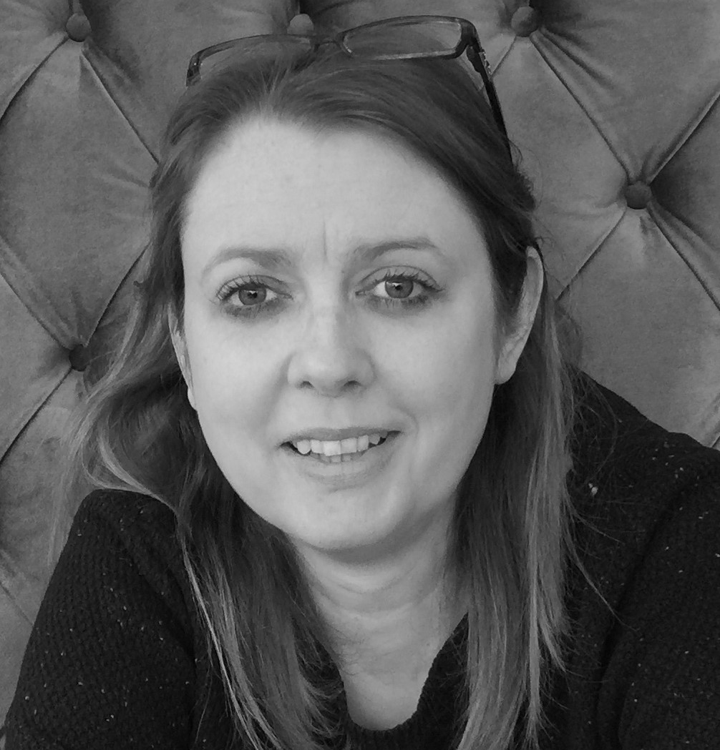
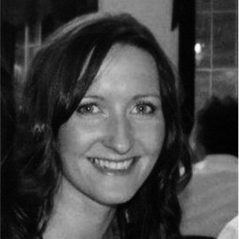
Our project team
Sarah Dirrane
Director, Research & Strategy
Kate Wood
Senior Research Associate
Fiona Smalley
Senior Research Associate
Trained researcher – Masters in Research Methodology at University of Leeds
Experienced in delivering multi-method research programmes across both qualitative & quantitative research methods
Led on evaluation & Impact programme for Uni Connect consortiums and access/outreach initiatives
Delivered research & evaluation services in the education, HEI and public sectors
Developed Access & Participation Plans – deep understanding of the wider access and outreach context
Knowledge & understanding of the HEI sector – led the research & Intelligence Team for 5 years at a large HEI
Over 25 years qualitative research experience
Degree in Psychology & Sociology
Former Head of Qualitative Research at a leading Research Agency
Much experience of working with the education sector, interviewing young people, teachers and those working in the Higher Education sector in areas such as BAME, Inclusion, Access & Participation and Evaluation & Impact.
Former School Governor with a remit for working with teachers to improve Teaching & Learning in a school with high levels of deprivation and Pupil Premium
Over 20yrs qualitative research experience.
Degree in English Literature and Sociology.
Director/founder of two Qualitative Research Agencies.
Experience of the education sector via work for Sheffield Hallam and Hull University.
Experience of researching school intervention programmes run by commercial brands (Nike, Buxton Water)
Experience of researching impact of school related sports programmes on integration and inclusion within multi-ethnic communities.

Slide 120

Our experience
“Cosmos Engagement Ltd. have proven themselves to be a highly skilled professional company who work with dedication and enthusiasm towards meeting their client’s brief. They were able to provide advanced analytical skills that produced valuable insights into the attitudes and needs of our students. The report that was produced was on brief, detailed, well evidenced and engaging in style …. provided excellent customer care, keeping us updated on progress and meeting the changing needs of the project with good grace. Thank you to everyone involved for all of their hard work”
Emily Rozier, Head of Funding, Graduation & Awards : University of Birmingham
Cosmos has extensive experience working in the education and impact evaluation sector, having worked with a large number of HE clients. Cosmos specialises in delivering HE research programmes across a wide range of disciplines and methods - this includes quantitative, qualitative, empirical & secondary research. Cosmos has delivered innovative research programmes that have been recognised by the Office for Students as ‘exemplary’. Cosmos has also supported delivery of a ‘sector leading’ impact research programme with a partner institution. Further to this, a recent Cosmos report has been recognised by and presented to the House of Lords, in order to inform and aid development of new policies.
“Really delighted with the data analysis work Cosmos have undertaken for us. Many thanks for your attention to detail, clear communication, and quality reporting within agreed timescales – great service.”
Anna Woodhosue, Uni Connect Research & Evaluation Manager: University of Leeds
Cosmos was commissioned to carry out advanced statistical analysis of a survey that had been commissioned by the university.
Comsos was required to analyse 6,500+ survey responses across a number of pre-determined variables.
One of the key stakeholders for the project was the institution's partner schools and colleges, hence one of the project outputs involved developing individual reports for each school / college – in an accessible format. The individual reports formed a key part of the university’s strategic partner plans and provision allocation.
CASE STUDY
Experienced in qualitative student segmentation:
Cosmos has led on a large qualitative student segmentation project for a northern HEI, identifying key potential customer segments for the university. This involved a mixed-methods approach that triangulated both qualitative and quantitative data. The segments included both UG and PG audiences and were brought to life by multi-media. Given the multi-cultural composition of the university, there was also a focus on including BAME communities within the sample. Cosmos then also helped to embed the segments within the marketing departments and wider university departments to ensure that the relevant messages were being tailored for each target segment, which led to increased engagement and conversion by potential students during their student journey.

Slide 121








Our experience
Cosmos was commissioned to undertake a research project to help the university understand the impact and experiences of those who have received one their bursary awards
The project was part of a wider multi-method research programme involving:
Running an online survey - managing the responses and sending / managing email invitations & reminders. Response of nearly 2,000 students. Response rate was 50% higher than the target of 1,000 responses
Qualitative F2F interviews – recruited from the online survey
Secondary analysis of multiple datasets with 100,000+ data points, in order to create a logic model.
The survey was developed with guidance and approval from the university and scripted using an online survey design platform, in an engaging and easy to use format. It was also optimised via. omni-channel options to ensure a smooth user experience.
The university has used the results as a basis for their strategic review of the full awards package. The findings have ensured that students who have benefitted the most from the awards package were included in the revised award offer.
A selection of our HE clients:
CASE STUDY

Slide 122








Our clients
We also have extensive experience working in the Uni Connect space. Our clients include…

Slide 123
Cosmos
Nexus, University of Leeds, Discovery Way, Leeds LS2 3AA
T | 0113 887 0191
W | www.cosmosltd.uk
E | hello@cosmosltd.uk

