Slide 1
Communicating Confidently
Why good communication is key to your future progression
Notes:
The slides in this PowerPoint can be adapted/removed depending on the school/time restraints of each area.

Slide 2
Notes:
Introduction to Hello Future
[Presenter] Introduce the Hello Future Programme, to cover:
Our main aim: to help students to progress on to Higher Education (explain this term, including University, Higher Apprenticeships)
What we do: covering our schools programme as well as past and upcoming out of school events and activities.
More information on these can be found at: www.hellofuture.ac.uk

Slide 3
Aims and Outcomes:
Explore how communicating confidently can benefit you in education and the workplace.
Identify your individual communication skills and areas for improvement
Practise your communication skills in groups and identify your own goals.
Notes:
Short-term outcomes:
Learners can describe confidence and communication and recognise the benefits of communicating effectively in education and employment.
Learners can assess their own communication style and identify areas for improvement.
Learners have an awareness of how to utilise communication skills for F.E. or H.E. Level interviews.
Learners are able to recall and explain terms used in H.E.
Learners have practiced speaking about themselves in front of others.

Slide 4
Why Does It Matter?
Being able to express yourself clearly and confidently is a skill that can be practiced and developed. This helps you to sell your strengths, especially to universities and employers
Notes:
Explain why communicating confidently matters to learners.

Slide 5
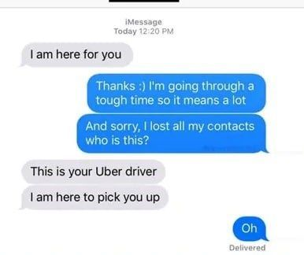
Notes:
Opening Activity
- Show the first text message on screen, and ask the learners what they think this means or how they would respond.
Show the replies. These might not be the answers that the learners would expect.
Ask the learners what would have stopped this mix up?
Answers usually include;
-if you were certain of who the text was from, - if they were clearer in their messaging,
- if they were speaking face to face.
This is to emphasise how there are many complicated aspects of communication. We interpret things differently and there are a lot more variables to be conscious of such as tone, body language and expression.

Slide 6
Verbal communication: the spoken word and how you use your voice. Do you sound nervous or relaxed? This also includes written communication
Non-verbal communication: body language and facial expressions. How we dress also communicates information.
Notes:
Then ask the learners what they think the following quote means: ‘You cannot not communicate’
We’re always communicating, whether we want to or not. We can communicate the more obvious way, which is verbally (click for pop-up), or we communicate through our body language and facial expressions (click for pop-up). Click for pie chart pop-up (body language is a lot more important than we might think)
Source- https://quotefancy.com/quote/1461052/Paul-Watzlawick-You-cannot-not-communicate

Slide 7
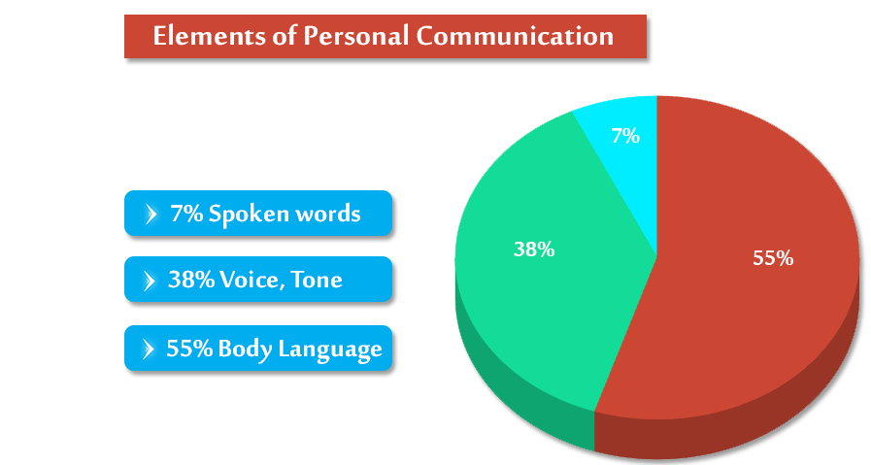
Elements of personal Communication
Notes:
Learners must try and guess the following percentages.
Discuss whether this surprises them and why/why not?
Source- Professor Albert Mehrabian of University of California Los Angeles

Slide 8
How Do I Communicate?
On your skills audit highlight three of your communication strengths and three areas for development.
I let other people have their say in a discussion
I feel confident talking to new people
I speak clearly
I can explain things to other people
Active listening – I pay attention when people talk to me
I am confident speaking in a group activity
I feel confident doing presentations
I think about what I am going to say
Notes:
Learners to reflect using the skills audit, highlighting three of their communication strengths, and three areas for development. Examples of what this might include on the slide.

Slide 9
Just A Minute
Take it in turns to speak for one full minute on a random subject.
If you hesitate, repeat yourself or deviate then an opponent can challenge you and take the subject.
You cannot say ‘er’, ‘erm’, ‘um’ or ‘ahh’.
Notes:
Round Robin Games – Find opportunities to practise a skill you need to develop
Just a minute – use mini whiteboards to write the subject so you remember what words you can use. This game is useful for:
Speaking in front of small groups
Thinking on the spot
This is often given to applicants of graduate schemes, e.g.!
Where to go from here:
Take notes – did this raise any questions you might want the answer to? Find them out!
Start your wider reading: Books, films, documentaries, TV, social media.
Get used to chatting about it or find people with similar interests.

Slide 10
Room 101
Nominate a chair and split the group into teams
Choose an item to banish to Room 101, never to be seen again.
Each team must present to the chair why their item will be banished to room 101. The chair will decide the most convincing argument.
Notes:
Round Robin Games – Find opportunities to practise a skill you need to develop
Room 101 – split group into two (choose a subject or object as a group) then argue against each other. Students to be both host and guest. Staff to facilitate.

Slide 11
Argumentation Station
Pick a card and use it to prompt whole group discussions – everyone must take part in some way
The questions are asked not to hear the ‘correct’ answer but to encourage you to think out loud.
Notes:
Round Robin Games – Find opportunities to practise a skill you need to develop
Argumentation Station – A whole-group discussions to get you thinking out loud and developing confidence in talking about a subject
Explain to the learners that the questions were taken from Oxford University interview questions. There are no right or wrong answers to these and they are designed to help you to think and discuss in a group setting and practice your group communication skills when expressing your opinions.

Slide 12
How would you
approach this?
Notes:
Ask the learners: How do formal settings make you feel?
What might be different from how you have communicated in the activities today?
Answers may include: verbal and non-verbal communication e.g. posture, professional language (the shared way of speaking and understanding each other that is used in the workplace, has no slang, and is spoken clearly and respectfully)
Emphasise that they will all face this situation next year or at some point the near future. This is nothing to worry about and each learner need to be conscious that it requires a different way of communicating and that they might want to practise this method.
Source- https://pxhere.com/en/photo/1446003

Slide 13
Choose the right style and tone
In an interview situation, consider:
Structuring your speech. Prepare answers to common questions using STAR – Situation, Task, Action, Result)
Notes:
The way you put your message across can mean different things depending on the context, the person being addressed, style, and tone of voice used.
Think about the points listed above.
- Structuring your speech. Explain to learners the STAR technique as a way to structure answers and provide evidence of your skills to the employer (Situation, Task, Action, Result)

Slide 14
Choose the right style and tone
In an interview situation, consider:
Structuring your speech. Prepare answers to common questions using STAR – Situation, Task, Action, Result)
Volume – loud enough to be clearly heard by everyone.
Speed of talking – not too fast!
Presentation – smart, clean, wear something that helps you feel confident and relaxed.
Notes:
Cover volume, Speed of talking, and presentation tips for interviews.

Slide 15
Positive examples include: leaning forward slightly to show your enthusiasm and nodding whenever is appropriate
Negative: Avoid nervous or bored body language like repeatedly crossing and uncrossing your legs or arms, fiddling with your hair or clothes, continually touching your face, scratching your head.
What do positive signals look like in an interview scenario?
Active listening – show you’re interested in someone. Concentrate on what they are saying, show that you’re listening (nodding and making eye contact), and respond appropriately e.g. ask a question
Maintain Eye Contact - lack of eye contact can lead your interviewer to think that you’re shy, disinterested, or dishonest. If you are speaking to more than one interviewer, be sure to look at each interviewer in the eye for at least a couple of seconds. Direct your answers to all the people in the room.
Notes:
We can give positive and negative signals when we talk to people. Ask the learners ‘What are examples of positive and negative signals in an interview scenario?’ They can discuss amongst themselves or aloud to the group.
The text on this slide includes some of the answers they may come up with.
Mention Shaking hands - while a limp handshake is bad, a bone-breaking handshake isn’t much better. Clasp your interviewer’s hand firmly and confidently, but don’t overdo it!

Slide 16
What next?
Take your Communication workbooks and take note of your strengths and areas of development
Find opportunities to practice – start small and keep at it!
Meet people in positions of authority – become comfortable talking to those in senior roles to help you feel more relaxed in formal (e.g. interview) situations. Ask for mock interviews!

Slide 17
Have any questions? Send us a direct message!
@HelloFutureCCOP
Notes:
Follow @HelloFutureCCOP on Twitter, Instagram and Facebook to find out more!

