Slide 1
Growth Mindset
How we can bounce back from failure and become more resilient
Notes:
The slides in this PowerPoint can be adapted/removed depending on the school/time restraints of each area.

Slide 2
Notes:
Introduction to Hello Future
[Presenter] Introduce themselves (and other staff member) and the Hello Future Programme, to cover:
Our main aim: to help students to progress on to Higher Education (explain this term, including University, Higher Apprenticeships)
What we do: covering our schools programme as well as past and upcoming out of school events and activities.
More information on these can be found at: www.hellofuture.ac.uk

Slide 3
Aims and Objectives:
Understand the basic concept of Growth Mindset and its application to your studies.
Identify positive and negative mindsets and how these can affect you.
Recognise that challenge can be positive.
Notes:
Learner outcomes:
Learners have explored their individual pathways to a career of their choice. ​
Learners acknowledge the importance of their voice and the value of their own opinions.​
Learners have expanded their knowledge in terms of the variety of future options available to them.​
Learners understand that personal values are unique to each young person.​
Learners witness the various HE journeys of Graduate Interns, whose journeys may reflect their own ambitions.​
Learners recognise the rewards in applying themselves to achieve their ideal career.

Slide 4
Why does it matter?
A Growth Mindset can help you with:
Self-confidence
Achieving goals
Studying or working in the fields you enjoy
Fulfilling your potential!
Notes:
Why does Growth Mindset matter? Give some context around the usefulness.
Self-confidence
Achieving goals
Studying or working in the fields you enjoy
Fulfilling your potential!
Explain that later in the session, you will unpick the term ‘Growth Mindset’ and explore what it means further.

Slide 5
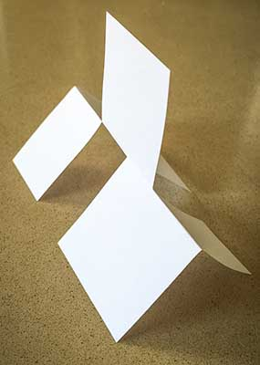
The Paper Challenge
You have 5 minutes to recreate this paper structure.
Only 1 in 30 can complete this challenge!
Notes:
Introduce the challenge in a way that encourages ‘Fixed Mindset’. Don't give the students any further instruction. Once they have started, start to write down the language that you hear being used in the room. You are likely to hear Fixed Mindset quotes such as ‘this is impossible’ and ‘I give up’.
Once the 10 minutes is up or the task has ground to a halt, start to discuss how the students found the task.
How did you feel when I introduced the challenge?
What was it like when someone else got it?
Did you look at what other people were doing? Why? How did it make you feel? Did you learn anything from what they were doing?
Discuss the language you observed, e.g. phrases like ‘this is too hard’. Encourage students to think about how they approach a challenge, using examples such as:
Football match
Job interview
Audition for X-Factor
Any challenge relevant to your students
How you choose to take on challenges is all dependent on mindset – briefly introduce growth and fixed mindsets (can use examples of these that you heard from learners during the task).

Slide 6
The solution…
1) Fold the paper in half until you have a crease along the middle – as indicated by the blue line.
2) Cut three lines towards the middle – as indicated by the dotted lines.
3) Twist the paper by holding the two ends until you re-create the structure.
Notes:
Explain the solution to the task – showing that it was possible.

Slide 7
‘Fixed’ vs. ‘Growth’
Notes:
We can view and approach challenges in two very different ways, and it’s all dependent on our mindset.
Explain ‘Fixed’ and ‘Growth’ mindsets.
Explain how these two approaches affect how people react to challenges, e.g. aiming for a dream job.
Ask what type of mindset they think they have (think back to the challenge)? Do they have bits of both?
A key point is that mindsets can change!
Move to the cards activity here:
Ask learners to sort the cards into two piles - Fixed Mindset statements and Growth Mindset statements. After they have completed the task, ask learners to share examples of the two mindsets with the rest of the class.
[presenter] The answers to this task are displayed on the next slide on the head images, therefore, ensure this remains hidden whilst learners complete the task.

Slide 8
Notes:
Once learners have shared the examples with the class, bring up this slide to display all of the examples.
We can view and approach challenges in two very different ways, and it’s all dependent on our mindset.
A key point is that mindsets can change!
Source: https://medium.com/leadership-motivation-and-impact/fixed-v-growth-mindset-902e7d0081b3

Slide 9
Neuroplasticity
Notes:
https://gfycat.com/gifs/search/neuroplasticity
Source: https://www.youtube.com/watch?v=ELpfYCZa87g
For task – see session plan.
Once the task has been completed, play the video - this video can give a scientific basis to what has been discussed.

Slide 10
Cup-stacking challenge
Notes:
Learners work in teams and start with 6 cups stacked in one pile. They must all work together to create a pyramid using both the elastic bands and the string and cannot touch any part of the cup with their bodies.
Allow some time for learners to try the task and for you to establish if everyone is attempting the task whilst following all rules.
After the first turn, explain the Fail Well Cycle from the booklets and get learners to talk through what worked, what didn’t and what they would do differently next time.
Set learners off to try again, this time in a race.

Slide 11
What happened? List the facts
Take responsibility for your actions: What worked, and didn’t?
What will I do differently next time?
Take action: Give it another try!
Reflect on improvements
The Fail Well Cycle
Notes:
Talk through the Fail Well Cycle in relation to the cup task. Even if learners have done it correctly, there will be areas they can build on for the race version of the task.
Elaborate that this cycle can be used to look at any task that has not gone as well as the learner hoped/anticipated. Relate this to current school work.

Slide 12
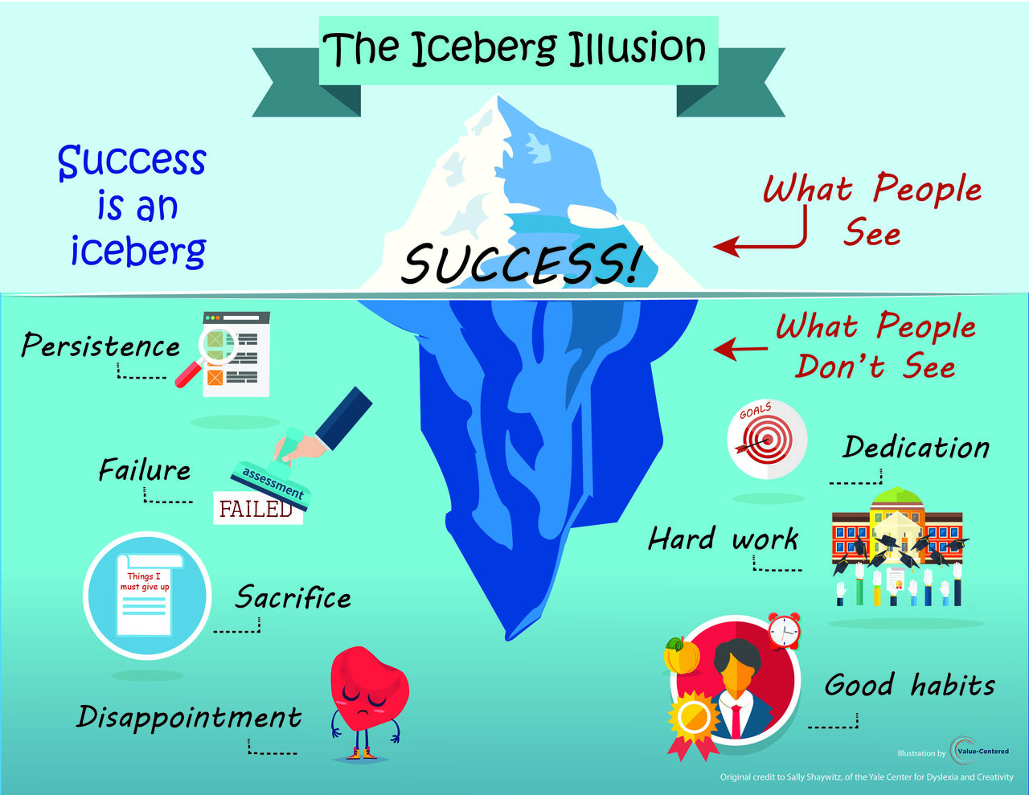
Notes:
Explaining the Iceberg Illusion and how, when it comes to success, we only see the end result, not all the hard work and challenges that went into it.
Give an example of a famous person who has overcome obstacles to reach their stage of success. An example would be that JK Rowling was rejected by many publishers and now the Harry Potter series is one of the most successful book series of all time.
Explain that success is not something that is predetermined, but something that needs to be worked for.
Learners are then to work in groups to choose someone they admire, and list the ‘visible’ and ‘invisible’ parts of their success.
Original credit for image: Sally Shaywitz - of the Yale Center for Dyslexia and Creativity.

Slide 13
How can I use growth mindset to achieve my goals?
How can I use a Growth Mindset to achieve my goals?
In school
Outside of school
In my Future
Notes:
Tying session together by bringing it back to something tangible. Ask students to write three Growth Mindset statements they could use to achieve their goals in their booklets, eg:
1. In school (subject you don’t enjoy or struggle with)
2. In your personal life (sports team, drama group, learning something new?)
3. In your future (career, university, apprenticeship)
Link the session to HE progression here and mention idea of potential. If you have a Fixed Mindset, you may not reach your full potential because you’ll be putting limits on yourself.

Slide 14
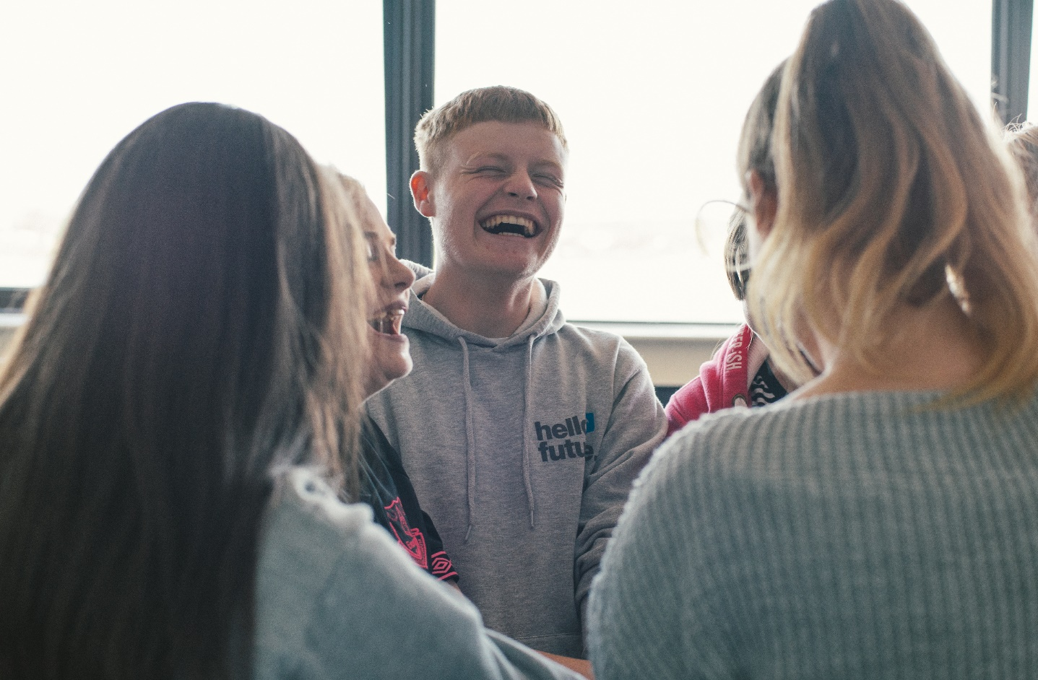
Follow us to find out how you can get involved!
@HelloFutureCCOP
Notes:
Follow @HelloFutureCCOP on Twitter, Instagram and Facebook to find out more!

