Slide 1
Preparing for student life
Notes:
The slides in this PowerPoint can be adapted/removed depending on the school/time restraints of each area.

Slide 2
Notes:
Introduction to Hello Future
[Presenter] Introduce the Hello Future Programme, to cover:
Our main aim: to help students to progress on to Higher Education (explain this term, including University, Higher Apprenticeships)
What we do: covering our schools programme as well as past and upcoming out of school events and activities.
More information on these can be found at: www.hellofuture.ac.uk

Slide 3
Aims and Outcomes:
Prepare to thoroughly research your university options​.
Explore what is important to you when considering a university.​
Understand this is a big decision but that we can overcome any barriers we face by considering all the elements.

Slide 4
What’s best for you?
University or Apprenticeships
Earning now or earning later
Moving away or staying at home
Study in a busy city or on-campus?
Living with people or living on your own
Old hobbies or new societies
Notes:
Stand up sit down
University or Apprenticeships – right now! Would you prefer to go to university or do an apprenticeship
Earning now or earning later – Would you like to start making as soon as you leave school or continue with your studies and start earning money at a later date with the possibility of a higher salary. Practitioner highlights continuing to study further includes higher and degree apprenticeships.
Moving away or staying at home – In the near future would you like to move away or stay in the home area
Study or work in a busy city or study on campus? Do you prefer city’s (Use Carlisle as example with UoC) or would you prefer to study on-campus like Lancaster University?
Living with people or living on your own – Would you prefer to share a house/flat with other people or would you like to live on your own?
Old hobbies or new societies – Would you like to continue with your current hobbies or would you like to try something new in a new location?

Slide 5
Who offer’s degree apprenticeships?
Employers
Aerospace Engineering – Airbus, BAE Systems, Rolls Royce
Healthcare – NHS, Bupa
Nuclear – EDF Energy, Magnox LTD, Sellafield
Universities
Aerospace Engineering – UCLan, Lancaster University, University of West England
Healthcare – University of Birmingham, University of Salford, Sheffield Hallam University
Nuclear – University of Bristol, University of Cumbria, University of Manchester
Notes:
What is a degree Apprenticeship? Ask learners about what they already know.
Look into where they are advertised
Add logos of companies and universities
Can you have this through an employer or college (EXPLORE)

Slide 6
Living as an apprentice
Things to consider:
Budget
Transport links
Location – home or away
Share a flat or live with parents
Bursaries
JCPlus
Notes:
Whether you are deciding to move away or stay at home to complete an apprenticeship, There are many things to consider: (Hello Future staff to explain some of these can be applicable to university students, with something like “Some of this will be covered later in the presentation”.
Budget – This is a big thing to consider and can massively contribute to your careers in a positive way if you are smart about it. Hello Future staff to ask questions throughout and share experiences on how they did this: “Who is good at saving money?” “What do you spend your money on?” “Do you feel like you need to spend __ amount on __ or could you do without?” Transport Links – If you consider to move away from home then you may want to consider transport links, that could be to the workplace or again, to university. It may be useful to plan accommodation around this given the location of your workplace/university.
Location – Depending on your situation you may need to consider things such as location and whether you will need these transport links or even a car/ You may decide you need to live near a bus station because the bus drops you right outside and saves hassle of driving a car or using train services.
Living arrangements – Organising living arrangements and understanding what option you would like to take can affect your performance in a working situation. Although it is a big decision, it impacts positively on you if you are in the right surroundings to study Some living arrangement considerations: Would you rather stay at home and save more money being around family? Would you like that independence of living on your own? Or would you prefer to share a flat with a friend?
Support:
Bursaries – A bursary is money that you, or your education or training provider, can use to pay for things like:
- Clothing, books and other equipment for your course
Transport and lunch on days you study or train
Aged 16-19 Bursary -
You could get a bursary to help with education-related costs if you’re aged 16 to 19 and:
studying at a publicly funded school or college in England - not a university or
On a training course, including unpaid work experience
A publicly funded school is one that does not charge you for attending it
JCPlus

Slide 7
Budgeting Activity
Notes:
The class will be split into 4 groups of 12
10 university ‘essentials’ that can be considered such as: Transport, Hobbies (Sports etc), Clothes, Phone, School Supplies, Savings, Social Events (Cinema etc.), Toiletries, TV/Netflix, Other, and will be placed on the presentation.
Learners choose the 5 amenities that matter most to them just by looking at them.
“Now let's imagine you get the average student maintenance loan of £2400 a term, so £800 month”. “Then imagine you must pay £400 a month for rent and £200 for food, leaving you with just £200. Now turn over the page and based on what you have already filled out, how well do your essentials price up against the £200 budget you now have? " "Now I want you to choose five new essentials based on your new budget of £200”. (5 minutes) Member of staff to speak to learners and discuss throughout groups and refer to slideshow with prices on)
Questions for member of staff to consider: - Raise your hand if you had to change a lot? - What did you take out and why? - Are your choices realistic given your 'hypothetical' circumstance? - Could you get a cheaper phone contract for example? - Do you really need another T-shirt or dress?

Slide 8
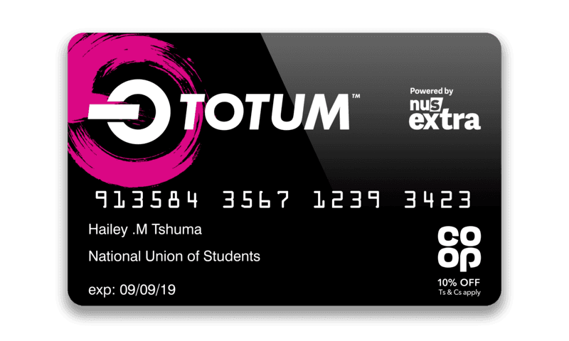
How to Budget?
Notes:
Discuss our examples of cost cutting - Joint TV subscriptions, - Discount sites such as Unidays and StudentBeans which offer discount codes on things like clothes and events (JR: Constantly used Groupon and Vouchercloud to buy in bulk, cheap meals out etc.) - Using comparison websites to cut costs on phone tariffs. - “Cities such as Liverpool and Newcastle especially, offer student days (once a year) throughout the city Centre giving students the opportunities to win things like vouchers for clothing or free meals out. There are also student lock ins where shopping center's close for a period of time to open exclusively for students to grab some deals”.
Please note: Any other appropriate examples that have been used by Hello Future member of staff is welcomed..

Slide 9
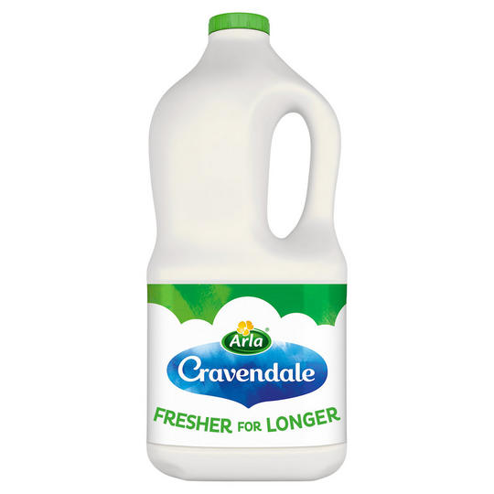
Guess the price?
75ml £3.80
£1.50
£1.85
£1.50
£1.10
125ml £0.69
Notes:
Guess the price activity
- After prioritizing what essentials each learner needs in the Budgeting activity, we move onto Guess the price.
Work way through each comparison and explain that the exact same product is available for considerably less than the brands they would normally associate with the product.
Give time between each transition for learners to shout out their thoughts and engage as much as possible in the activity.
The activity aims to debunk myths that students can cut costs without it affecting their standards of living
Hello Future staff to draw on their experiences with doing the ‘student shop’ and how being savvy with your money can enable you to do other things such as go out for nice meals and socialize more with friends.

Slide 10
Choosing a course
Things to consider:
Entry/subject requirements – eg for Medicine you will need the Sciences and Maths.
Course modules – the same degree will look vastly different at different universities.
Assessment styles – do you prefer exams or coursework?
Joint or single honours? – eg BA History, or BA History and Politics?
Notes:
Demonstrating how to use UCAS course search function to show range of courses in different areas. Show how to find important information, eg entry requirements, modules included. Leading discussion on what is important for students, eg the list above.
Possibility for the ‘this or that’ game to get an idea on some of the preferences the students have.

Slide 11
Choosing a university
Things to consider:
Entry requirements
Location
City or campus university
Scholarships
Study abroad options
Facilities, eg sports, cafes, library
Notes:
Leading discussion on what is important for students, eg the list above.
Moving on here to ‘my perfect university task’, where students select options from a ‘menu’.

Slide 12
Student accommodation
Things to consider:
Budget
Location
Mixed or single gender?
Loud and social or smaller and quieter?
Shared bathroom or en suite accommodation?
Notes:
Showing a ‘virtual tour’ of student accommodation from a university website (eg https://www.gla.ac.uk/undergraduate/accommodation/residenceprofiles/) and discussing various types of halls available. Use this opportunity to mention your own university accommodation experience.

Slide 13
My Perfect University
In groups of 3 or 4 design a poster to showcase your perfect university .
Use some idea’s already covered today and ask teachers and hello future staff what their perfect university would have been.
Notes:
10 minute activity – My perfect University 1. Split the class into groups (around 6 per group dependent on class size). Ask each group to design a poster outlining what would feature in their ‘perfect university’. - This task can be demonstrated on A3 paper with pens.
2. Staff to Encourage students to think about some of the topics covered in the session to create discussion in their teams. e.g. en suite bathroom? city or on campus? Double bed? Do you want the University to have a sports team? Staff can draw on personal experiences and ask if this is important to them like it was to them (What did I enjoy the most? What was essential to me?)
3. Ask for a couple of groups to present their posters to the rest of the class. Alternatively get them to feedback to other groups and switch tables.
During the activity this is a great chance to find out from students some of the worries they have about university and debunk them where appropriate at the end.

Slide 14
Life outside of study
Volunteering
Clubs and Societies
New environments
Discounts – Totum Card, NUS Apprentice Extra!
Leisure activities
Notes:
Clubs and societies – There are plenty of clubs and societies you as a student can get involved in. They can be sports clubs or societies around hobbies and interests of yours to allow you to network with new people and make friends. Link: https://www.flickr.com/photos/stephoto27/32223952168
Discounts – As previously mentioned … Totum card can help you save money on top brands for groceries, phone contracts, gym equipment and plenty of other essentials! https://www.pexels.com/photo/photo-of-discount-sign-2529787/ Leisure – This can be time to spend doing your hobbies, you could go to a music event or you could want to meet up with your friends and have a chat. https://www.pxfuel.com/en/free-photo-xcxhd
https://www.pexels.com/photo/group-of-people-sitting-on-white-mat-on-grass-field-745045/
New environments – Choosing to live in a different area can give you chance to explore the local culture in and around your new accommodation. For example, if you were to study at UoC then you could visit some tourist attractions such as Carlisle castle or Preston North End FC at UCLAN. Link: Carlisle Castle https://www.flickr.com/photos/bods/3923590943 Preston https://www.geograph.org.uk/photo/1588268 Volunteering – You could become a student ambassador to support learners and get involved in exciting projects within the university regarding the students. You could also volunteer in the library.
https://www.jisc.ac.uk/blog/how-jisc-and-tech-can-support-you-during-second-wave-of-area-reviews-19-jan-2016

Slide 15
What’s the point?
VS
£22,000
£31,000
Notes:
Fact check this and update
So if you’re earning around £26k a year, you want to spend that on the things you want to spend it on don’t you? That £90 a year you’re paying towards your student loan could be spent on something else, that would get you about 6.4 large margarita pizza’s from Dominoes, or 22 and a half tubs of your favourite Ben and Jerry’s ice cream.
On average, someone of working age without a degree is making £22,000 a year. This is also a great wage. However, when you have a degree your value massively increases because of all the skills and expertise your education has helped you to develop. So on average, someone of working age with a degree is making about £31,000 a year. This is a whopping £9,000 more than someone without a degree. Of course money shouldn't ever be the sole incentive, but it's a good example. Those people are earning more because they are more skilled and therefore the pool of jobs they are applying for increases massively.

Slide 16
Have any questions? Send us a direct message!
@HelloFutureCCOP
Notes:
Follow @HelloFutureCCOP on Twitter, Instagram and Facebook to find out more!

Slide 17
Notes:
General sources:
https://www.reed.co.uk/career-advice/levels-of-education-what-do-they-mean/
https://www.gov.uk/what-different-qualification-levels-mean/list-of-qualification-levels
https://www.ucas.com/
https://university.which.co.uk/

