Slide 1
Study Well

Slide 2
Notes:
Introduction to Hello Future
[Presenter] Introduce the Hello Future Programme, to cover:
Our main aim: to help learners to progress on to Higher Education (explain this term, including University, Higher Apprenticeships)
What we do: covering our schools programme as well as past and upcoming out of school events and activities.
More information on these can be found at: www.hellofuture.ac.uk

Slide 3
Aims and Outcomes:
Identify a study style that aids effective revision
Describe how lifestyle factors impact your own education
Reflect dealing with stressful situations
Notes:
Learner Outcomes
Learners can identify a range of lifestyle factors.
Learners can describe how lifestyle factors impact on their own lives.
Learners can reflect on how to make changes to reduce negative effects and promote positive ones.
Learners can identify how lifestyle factors may impact education.

Slide 4
323
days
until results day
Notes:
[Explain that you are going to begin the session with a guessing game – there will be a prize for the person who guesses correctly]
Learners must guess what the number on the board is a countdown to – the presenter will have to edit this number as it will be dependent on the date of delivery.
Once the learners have guessed (if they haven’t – give the prize to the guess which was closest) you can reveal the next animation ‘until results day’

Slide 5
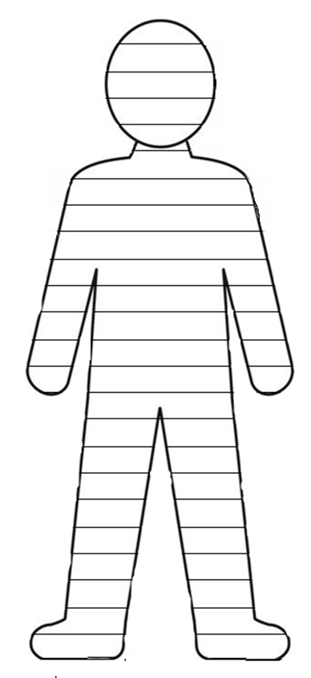
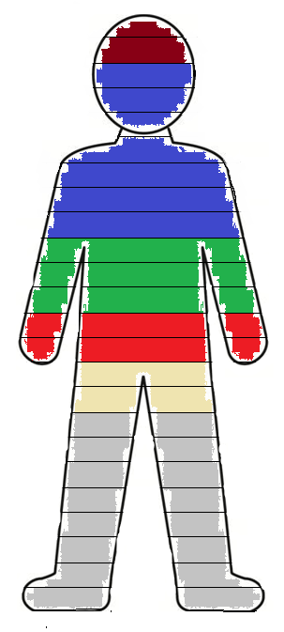
Eating
At School
TV/Films
Youtube
Instagram
Sleeping
Think about what you spend your time doing on an average day, and fill in this body template to reflect this (each row is 1 hour)
Things to consider:
Sleeping
Your favourite Apps i.e. TikTok, Snapchat
Your favourite Social Media i.e. Instagram, Twitter
Games i.e. Xbox
Other

Slide 6
Why don't we revise?
I am a procrastinator!
It’s too boring!
Too tired!
Feeling Stressed!
Distracted!
Notes:
Why don’t we revise? - Get the learners to discuss in pairs/groups the reasons they avoid homework and revision [stress they can be any reason and each answer is valid]
Ask learners and staff around the room if they have ever used one of the following excuses [this can be done as stand up sit down/or raise your hand if...]
‘It’s too boring’ – have you ever put off revision because you find a subject or a task boring?
‘I’m a procrastinator’ – are you someone who always finds something else to do? Sometimes to the extent that you start doing different mundane tasks to put off from revision (such as doing the dishes or tidying your room)
Sat down to revise but then got distracted halfway through and didn’t finish the task
‘Too tired’ – are you too tired or overwhelmed with balancing all your revision and homework already?
Explain that you will address each of these excuses with practical ways or ‘revision hacks’ to get over them.

Slide 7
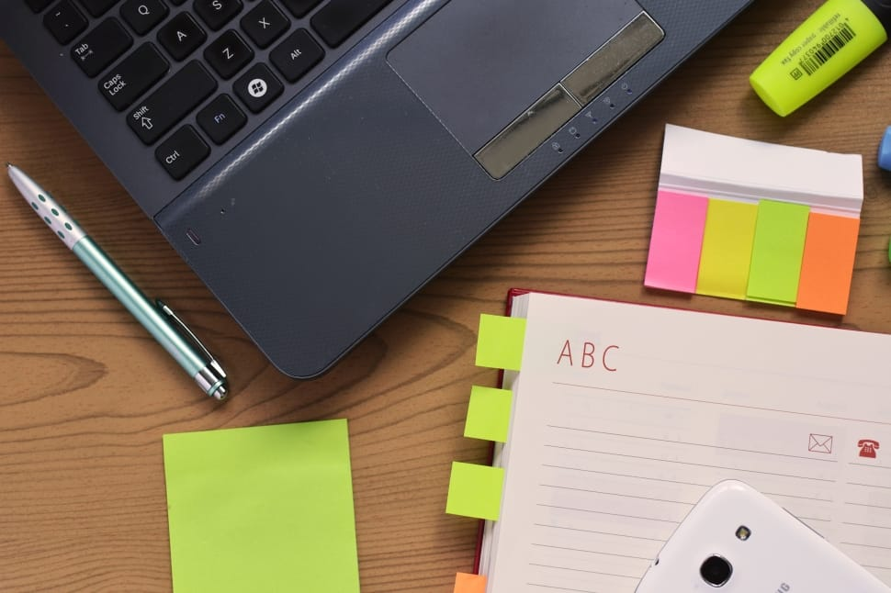
Too boring?
Switch things up!
Change the format to a way that works for you:
Try working in groups or pairs
Use different revision tools: mind-maps, post notes, whiteboards, record podcasts, revision cards, or your phone.
Do some ‘wider-reading’ – use YouTube or Google for inspiration
Notes:
If your excuse was – It’s too boring…
Make it interesting by switching things up – change the format and the way you revise. For example:
If you’re bored of working alone – sometimes when working in a group or pair – your friends can help make the subject more interesting – you can also share each other's knowledge. And plan in study breaks together.
Change the tools you use to revise – draw pictures, make your own colourful mind-maps, use post-it notes around the house in places which will help you to remember certain facts. Try using your phone to take notes – then look at it every now and then when you have a moment.
Doing some ‘wider-reading’ can help to make the subject interesting to you – try finding a documentary or revision video on YouTube – this will help by generating interest and giving more context to the subject that you are studying.

Slide 8
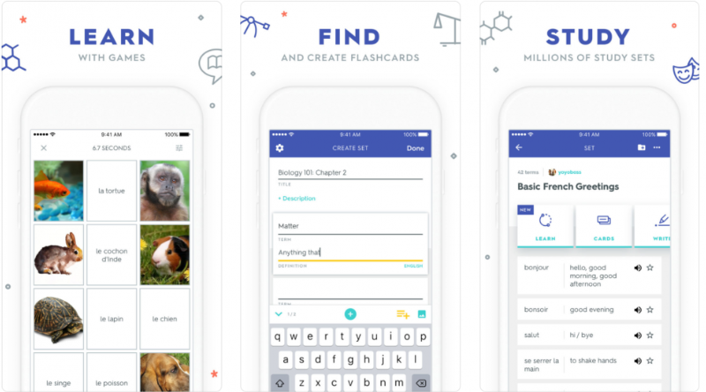
Too boring?
Try Quizlet!
Quizlet allows students and teachers to create their own quizzes and study sets. You can also access more than 200 million user-generated games and activities.
More than 95% of students who use Quizlet report an improvement in their grades.
Notes:
Emphasise that this app is an easy way to revise on the go.
You can create your own revision quizzes and games, and then use them to practice whenever you want. You can share them with your friends and also check out the resources that have already been created by other users.

Slide 9
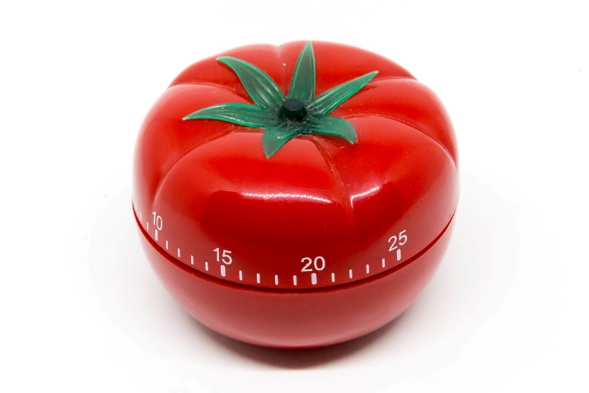
So you’re a ‘procrastinator’?
Be realistic!
Give yourself a realistic timetable and don’t over-plan!
Use the Tomato Timer Technique and plan in your 5-minute breaks
Get rid of or minimise distractions!
Notes:
If your excuse was - that you are a ‘procrastinator’
Set yourself a realistic timetable so you don’t fall guilty of over-planning and then not sticking to the plan - Try to make a revision plan for a week and see how well you stick to it. If it didn't work see what you can change for your plan for next time.
Use the tomato-timer technique – most learners will have come across this in school. A time management technique developed in the 1980s. The idea is to break down your work into 25minute intervals and give yourself 5 minutes in between those to do something unrelated.
Minimise distractions – try and put your phone in a different room, or have a friend check in with you every now and then to see your progress.

Slide 10
Notes:
Explain that you are going to stop talking about revision for two minutes – for a short break and then play the video.
Original Video: https://www.youtube.com/watch?v=FTcjzaqL0pE

Slide 11
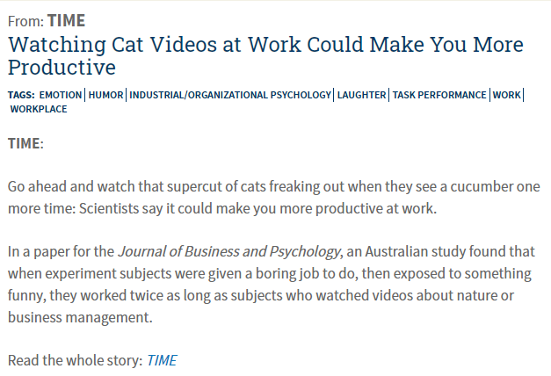
I am a procrastinator!
Notes:
Explain the above study: that a group of learners in an experiment were given the task to cross out the letter ‘e’ in a long body of text. One of the groups was given funny cat videos to watch – and it was found that the group was more productive.
Use the tomato timer technique to give yourself a fun 5 minute break – use procrastination to your advantage by planning in when you are going to procrastinate and by limiting yourself to a short 5 minute break to do it!
Full article: https://www.psychologicalscience.org/news/watching-cat-videos-at-work-could-make-you-more-productive.html

Slide 12
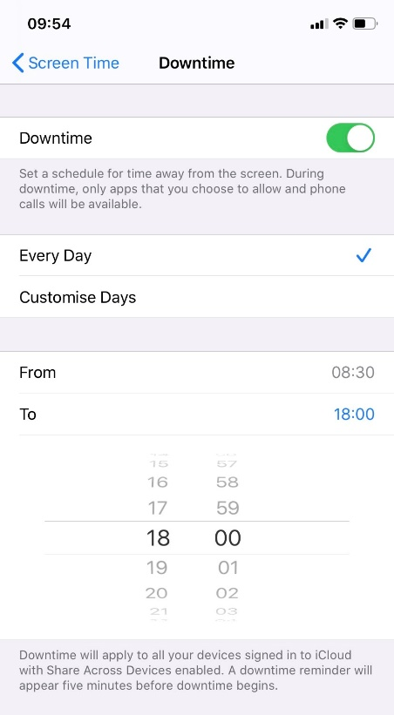
Distracted?
Create your environment
Revise where you feel most relaxed
Check out Study Playlists on YouTube
Keep hydrated (‘My Water Balance’ app)
Use screen time if your phone is a distraction
Notes:
If your excuse was - that you get distracted:
Think about creating your perfect environment:
Remove distractions - try turning your phone off if it distracts you or try turning notifications off or on silent. Try using screen time on your phone if it distracts you!
Check out Study Playlists on YouTube – these are created by and for learners to help you concentrate. Music can help you to be more productive. The songs should have no lyrics, so it doesn’t distract you.
Keep hydrated –the ‘My Water Balance’ app allows you to figure out your water requirements, set reminders to up the intake and see useful tips about H2O.
Revise somewhere you feel relaxed – this will be different for everyone. [at this point the presenter could describe what environment they preferred in school. E.g. ‘I used to like to revise next to a window in the library – I didn’t like revising at home because I wanted home to be the place I could relax and I wanted to keep home and revision separate’

Slide 13
Notes:
Sound Quiz: Explain to the learners that you are about to play a number of sounds – they must guess what they are:
Answers:
Snapchat notification sound
Snapchat Best Friend notification
X box sound
Messenger notification
Sound when you have sent an iMessage
Ask the learners ‘What happens when you hear that sound?’ Explain that these sounds were developed for our brains to respond to them immediately they have been known to trigger dopamine (the ‘feel good’ hormone) and also cortisol (the ‘stress’ hormone)

Slide 14
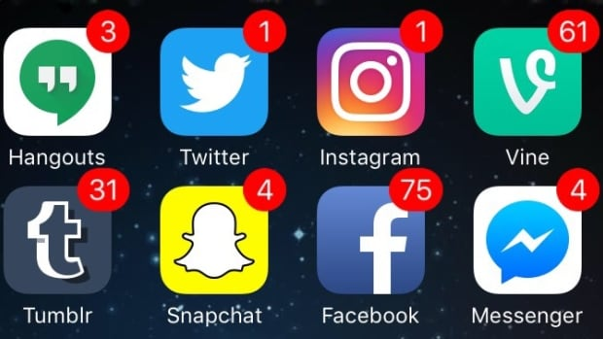
Distracted?
Notes:
Ask the learners how they feel when they see the first picture (badge notifications on apps) Answers usually include that the notifications need to be checked – can trigger group discussion on whether it annoys them if they leave notifications unchecked.
Explain that notifications are designed visually – through their use of colour – to trigger a reaction from your brain – like the sounds we have just heard.
Ask learners who use Instagram – if they have ever reached the bottom of their Instagram feed. Not many users have done this due to the invention of the ‘infinity scroll’ which the top social media apps use today. This means that a user should, hypothetically, never reach the bottom of their feed – there is always more information to be read and discovered.
Explain that technology and social media are a useful and ever expanding resource – but it is important to be aware of their impact on our lives so we can use it in moderation and to our advantage – so it doesn’t become an extra pressure in our lives.
Source: Infinite Scroll GIF - https://visualhierarchy.co/blog/wp-content/uploads/2015/09/infinite_scroll.gif

Slide 15
Feeling Stressed!
Work smarter not harder!
Take a break to do something you enjoy
Get some fresh air to clear your head and relax
Make time to get 30 mins of exercise 3 times a week
Find calming activities
Notes:
Get some exercise – it’s recommended for 13-19 year olds to get at least 30 mins of exercise 3 times a week.
Make sure you get some fresh air, it’ll help distress and clear your mind.
Take a break – this can be either a complete break or you can try and find calming activities i.e. drawing, jigsaws, use a Meditation or Mindfulness app to wind down and meditate
Don’t forget to do things you enjoy – remember to make time for your hobbies and interests.

Slide 16
Too Tired?
How much sleep do you really need?
8 – 10 hours
Memory processing
Restorative sleep
Reduces stress
Makes you more alert
Improves memory
Notes:
Ask the learners ‘How much sleep does a year 11 need?’
Young people between 13-19 years old need 8-10 hours of sleep to function best I.e. reduces stress, makes you alert, and improves memory.
Ask the question: ‘When you set an alarm for the morning, do you calculate how many hours sleep you will get before you wake up? How does this make you feel?’ It might cause a bit of unease for some learners when they think they won’t have many hours of sleep before they wake up in the morning. Explain that research has been moving towards the importance of having different sleep cycles as opposed to how many hours sleep a person gets.
Explain the following sleep cycles:
Between the hours of 11 and 3am = most non-REM cycles occur = restorative sleep for growth and healing.
Between the hours of 3am and 7am = most cycles are REM = memory processing.
Sometimes we think we can get more done in a day if you sleep less, but your brain is still working whilst you sleep – it’s processing memories and resting your body

Slide 17
What does Revision mean?
Notes:
Define revision: Revising is the study of work you have done, in order to prepare for an exam (Cambridge Dictionary)

Slide 18
Top Tips
Note Taking
Time
Management
Wellbeing
Wider Reading
Organisation ​
Notes:
Top Tips to Revise:
Wellbeing:
Remember to give yourself plenty of sleep during busy periods.
Stay healthy – drink water, get a good amount of exercise (30 minutes, 3 times a week) and try to get fresh air when you can
Skills:
Plan your time effectively and realistically
Do some wider reading or research to understand the subject in more detail

Slide 19
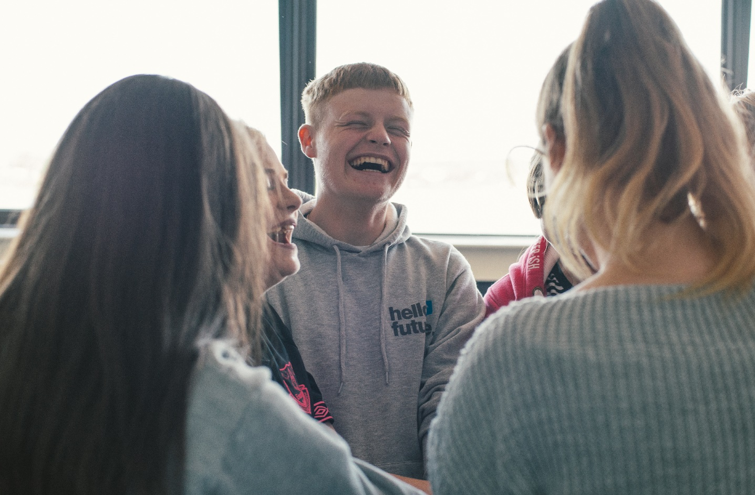
Follow us to find out how you can get involved!
@HelloFutureCCOP
Notes:
Follow @HelloFutureCCOP on Twitter, Instagram and Facebook to find out more!
If there is time – presenters may want to share some of their own top revision tips!

