Slide 1
Your Future
How we make decisions about our futures

Slide 2
Notes:
Introduction to Hello Future
[Presenter] Introduce the Hello Future Programme, to cover:
Our main aim: to help students to progress on to Higher Education (explain this term, including University, Higher Apprenticeships)
What we do: covering our schools programme as well as past and upcoming out of school events and activities.
More information on these can be found at: www.hellofuture.ac.uk

Slide 3
Aims and Outcomes:
Explore the individual pathway to a career of your choice.
Understand that personal values are unique to each individual.
Expand your knowledge on the variety of future options available to you.
Notes:
Learner outcomes:
Learners have explored their individual pathways to a career of their choice. ​
Learners acknowledge the importance of their voice and the value of their own opinions.​
Learners have expanded their knowledge in terms of the variety of future options available to them.​
Learners understand that personal values are unique to each young person.​
Learners witness the various HE journeys of Graduate Interns, whose journeys may reflect their own ambitions.​
Learners recognise the rewards in applying themselves to achieve their ideal career.​

Slide 4
What was your first childhood dream job?
Notes:
Discussion – first childhood dream job
[Presenter] Discuss with the person next to you – think back – what was the first dream job you had as a child. It can involve students, teachers, Hello Future staff.
[Discussion time] Staff to interact, listen to students and facilitate discussion.
Use examples from the room of childhood dream jobs. Establish that some of those ideas might have stayed the same, and some might have changed. Future choices might seem easier when we are younger and dream big. Going to cover what you might ask yourself now, to discover what your ideal career is.

Slide 5
What are your dream jobs now?
Notes:
Now ask learners to have a think about what their dream jobs are now. They then need to write 3 jobs at the top of the mountain in the activity booklet.
Emphasise that we are discussing this in a safe environment and that it is okay to dream big.

Slide 6
Organisation
Technology
Communication
Creativity
Teamwork
Extra Curricular Activities?
What is your favourite school day of the week?
What makes
you lose track of time?
Hobbies?
Notes:
Hand out post-it notes and ask learners to think about their interests & hobbies and skills & talents. Then ask learners to write this down on the post-it notes (10 mins)
Once they’ve done this, get each learner to put their post-it notes on the ‘Interests & Hobbies’ board and ‘Skills & Talents’ board which are placed around the room.
Encourage learners to discuss with one another whilst they are doing this. Use the PowerPoint slide for suggestions and prompts.
Once everyone has added them to the board, discuss a few examples, emphasising that everyone has different interests and hobbies.
Then ask learners to write the things they wrote on the post-it notes in their booklets (mountain).

Slide 7
This
That
or
Notes:
This or That game (5 mins)
Start off with trivial things, e.g. ‘Do you prefer Netflix or Youtube?’ and then move onto things that are more related to the workshop e.g. ‘When thinking about your future career, would you rather stay in Cumbria or move away from Cumbria?’
Students can answer by either standing at different sides of the room or by standing up and down (depending on space).
Explain that the ‘This or That’ game shows that everyone has different preferences of what they like and do not like and this is the same when thinking about your career. You may want to work in an office but your best friend may want to work outside. There is no right or wrong answer, it just depends on our own personal values.

Slide 8
Challenge
Social Life
Leadership
Your Values
Money
Travel
Teamwork
Notes:
This is a group task that works best in groups of 4-5. Hand out values cards. (5 mins)
Ask learners to separate the grey and the blue cards into two piles. For the first part of the activity, we only need the grey cards, so the blue cards can be put to one side.
Instruct learners to organise the grey cards in order of what is most and least important to the group. Emphasise to learners that they are working in a group and everyone needs to have their input. Some of the cards may be more or less important to certain learners in the group but emphasis that this is normal and part of the task is to discuss and come to an agreement.
Chose a few examples of grey cards and explain what they mean in the context of your future career, e.g. ‘To earn lots of money may be an important value to you’.
Once learners have ordered the grey cards, they will now also need the blue cards. (5 mins)
Instruct learners to pair the blue cards next to the grey cards to show which factors you think are involved in each.
For example – You might associate social life with good health – because having a good social life can have an effect on your wellbeing.
A quick round of the room – was it difficult to prioritise in groups – did you have disagreements? What generally was the most important value?

Slide 9
Independence – having my own space
Social Life – having time to meet my friends
Travel – I’d like to travel to New York one Day
Money
Job Security
Leadership
Family
Making a Difference
Job Security
Work Life Balance
Helping Others
Social Life
Challenge
Travel
Leadership
Independence
Teamwork
Learning
Flexibility
Money
Notes:
After a discussion, get the learners to write down their own most and least important values in the booklet. If short for time, ask students to make a note of their values and fill them out later.

Slide 10
What careers might I be interested in?
Notes:
Learners will now have had time to think about their interests, skills and values/priorities for their future career.
Bearing all of his in mind, ask the question ‘What careers might I be interested in?’
This can be the same as the three choices you made at the beginning, but it may also be slightly different. Fill in the three boxes in the booklet to reflect this.
(5 mins)

Slide 11
Experience new things
Speak to friends and family
‘Do something today that your future self will thank you for!’
Research different options
Recognise your strengths
GCSEs – get ready!
Start asking questions
Notes:
To conclude, some things to think about and do after this session (5 mins)
Research different options
Start asking questions – what skills might I need to pursue my dream career?
GCSE’s – have you chosen the right GCSE’s to match your dream career?
Speak to friends and family – share your goals and aspirations
Recognise your strengths
Experience new things
If there is time at the end of the session, show learners the National Careers Service website.
https://nationalcareersservice.direct.gov.uk/
Show learners that you can type in any career and it will show exactly what type of qualifications, skills, and experience you would need to do that role. It also includes information on things like salary.

Slide 12
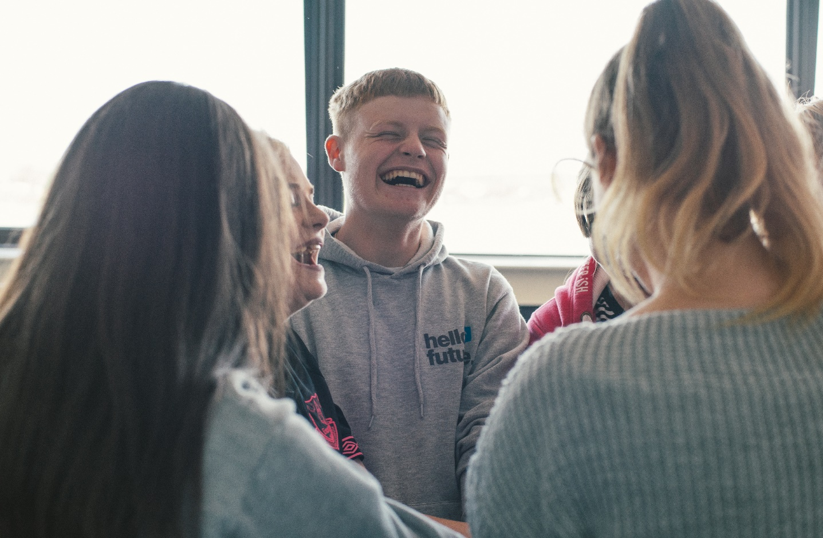
Follow us to find out how you can get involved!
@HelloFutureCCOP
Notes:
Follow @HelloFutureCCOP on Twitter, Instagram and Facebook to find out more!

